Slide 1
Welcome to the smokers show!
Dedicated to providing information about vaping to those who have not transitioned yet.
CONTACT INFORMATION:
Phil Busardo
Email: pbusardo@tasteyourjuice.com
YouTube: www.youtube.com/user/pbusardo
Website: www.tasteyourjuice.com
Facebook: www.facebook.com/phil.busardo
Dimitris Agrafiotis
Email: maddgreek@gmail.com
YouTube: www.youtube.com/vapingreek
Website: www.smokefreeradio.com
Facebook: https://www.facebook.com/vapingreek

Slide 2
THANK YOU to our primary sponsor!

Slide 3
Vaping is safe, right? WRONG! (Covered in all episodes)
Although most studies conclude that vaping is far safer than smoking, we strongly recommend that if you do neither, you continue to do neither.
Smoking = BAD
Reducing cigarettes through vaping = GOOD
Eliminating cigarettes through vaping = BETTER
Not smoking & not vaping = BEST
If you see a negative article about vaping, question whether or not that article compared the negative to that of a traditional combustible tobacco cigarette. If it does not, in our opinion it’s invalid.
Vaping is not harm elimination! Vaping is harm reduction!

Slide 4
WHAT THEY SAY!
Centers for Disease Control and Prevention (CDC): "E-cigarettes have the potential to benefit adult smokers who are not pregnant if used as a complete substitute for regular cigarettes and other smoked tobacco products."
Source: https://www.cdc.gov/tobacco/basic_information/e-cigarettes/about-e-cigarettes.html
The U.S. Department of Health and Human Services (HHS): “E-cigarettes present an important, potentially lifesaving opportunity to help currently addicted adult smokers quit combustible cigarettes.”
Source: https://www.hhs.gov/about/news/2018/11/15/secretary-azar-comments-on-data-showing-rising-ecigarette-use-among-youth.html

Slide 5
WHAT THEY SAY!
The U.S. Department of Health and Human Services (HHS): (HHS BLOG within the site) “Yet, while e-cigarettes are less harmful than regular combustible tobacco products—and a possible pathway to tobacco-smoking cessation for adults—the evidence on the effectiveness of these products for helping adult smokers quit completely is still uncertain.”
Source: https://www.hhs.gov/blog/2018/11/6/researchers-explore-health-effects-of-ecigarettes.html
Dr. Scott Gottlieb, Food and Drug Administration (FDA): "We believe e-cigs can provide substantial health benefits helping currently addicted adult smokers fully transition off of combustible cigarettes.“
Source: https://twitter.com/SGottliebFDA/status/1094631202491895810

Slide 6
WHAT THEY SAY!
Dr. Scott Gottlieb, Food and Drug Administration (FDA): "If you could take every adult smoker and fully switch them to e-cigarettes, that would have a substantial public health impact."
Source: https://twitter.com/SGottliebFDA/status/1094631202491895810
Dr. Scott Gottlieb, Food and Drug Administration (FDA): "E-cigarettes may present an important opportunity for adult smokers to transition off combustible tobacco products and onto nicotine delivery products that may not have the same level of tisks associated with them."
Source: https://www.fda.gov/NewsEvents/Newsroom/PressAnnouncements/UCM620185.htm

Slide 7
WHAT THEY SAY!
Dr. Scott Gottlieb, Food and Drug Administration (FDA): "We've said all along we think that e-cigarettes could be a viable alternative for adult smokers. If you could migrate more adult smokers off combustible products, that would be a net public health benefit."
Source: https://www.c-span.org/video/?c4780758/fda-commissioner-scott-gottlieb
Dr. Scott Gottlieb, Food and Drug Administration (FDA): "We see the possibility for ENDS products like e-cigarettes and other novel forms of nicotine delivery to provide a potentially less harmful alternative."
Source: https://www.fda.gov/NewsEvents/Newsroom/PressAnnouncements/ucm605432.htm

Slide 8
WHAT THEY SAY!
Mitch Zeller, Director, Center for Tobacco Products: "If we could get all of those people to completely switch all of their cigarettes for one of these non-combustible products, that would be good for public health."
Source: (page 31 or “document” page 27) https://www.govinfo.gov/content/pkg/CHRG-113shrg22614/pdf/CHRG-113shrg22614.pdf
National Academies of Sciences, Engineering, and Medicine: "Evidence suggests that while e-cigarettes are not without health risks, they are likely to be far less harmful than conventional cigarettes, the report says. They contain fewer numbers and lower levels of toxic substances than conventional cigarettes, and using e-cigarettes may help adults who smoke conventional cigarettes quit smoking. However, their long-term health effects are not yet clear."
Source: http://www8.nationalacademies.org/onpinews/newsitem.aspx?RecordID=24952

Slide 9
WHAT THEY SAY!
American Heart Association: “E-cigarettes either do not contain or have lower levels of several tobacco-derived harmful and potentially harmful constituents compared with cigarettes and smokeless tobacco. In comparison with NRTs, e-cigarette use has increased at an unprecedented rate, which presents an opportunity for harm reduction if smokers use them as substitutes for cigarettes.”
Source: https://www.ahajournals.org/doi/full/10.1161/CIR.0000000000000107
American Cancer Society: “Even though e-cigarettes do not contain any tobacco, the Food and Drug Administration (FDA) classifies them as “tobacco” products.”
“Research has found that e-cigarette use is likely to be significantly less harmful than smoking regular cigarettes.”
Source: https://www.cancer.org/cancer/cancer-causes/tobacco-and-cancer/e-cigarettes.html

Slide 10
WHAT THEY SAY!
American Cancer Society: “Based on currently available evidence, using current generation e-cigarettes is less harmful than smoking cigarettes, but the health effects of long-term use are not known.”
Source: https://www.cancer.org/healthy/stay-away-from-tobacco/e-cigarette-position-statement.html
Truth Initiative: “E-cigarettes are far less toxic than cigarettes, but they are not harmless.”
“Some smokers may be unable or unwilling to quit using nicotine and would benefit by completely switching to a much lower harm nicotine delivery mechanism (including potentially a well-regulated e-cigarette).
Source: https://truthinitiative.org/news/action-needed-e-cigarettes

Slide 11
WHAT THEY SAY!
Campaign for Tobacco-Free Kids: “Under the right circumstances, e-cigarettes could benefit public health if they help significantly reduce the number of people who use combustible cigarettes.”
Source: https://www.tobaccofreekids.org/assets/factsheets/0379.pdf
Royal College of Physicians: "Available data suggest that e-cigarette health risks are unlikely to exceed 5% of those associated with smoked tobacco products, and may well be substantially lower. In the UK, harm reduction is a recognized element of comprehensive tobacco control."
Source: https://www.rcplondon.ac.uk/projects/outputs/nicotine-without-smoke-tobacco-harm-reduction-0

Slide 12
What is vaping? (Covered in all episodes)
In the context of this show and information provided, vaping is the act of using an “EVP” or “E-liquid Vaping Product”.
The E-liquid may or may not contain nicotine.

Slide 13
So you want to switch to vaping!
Decide on your direction:
Open vs. closed system.
Large vs. small device.
Internal vs. removeable batteries.
All-In-One (AIO) vs. Traditional (510).
E-Liquid Types.

Slide 14
Hardware direction
Open vs. Closed system
Open – Pros:
Cheaper.
More selection and choices.
More e-liquid choice.
More customization.
More availability in vape shops.
Open Cons:
Learning curve.
Troubleshooting.
Filling.
Match e-liquid to hardware.
Limited selection in c-stores.

Slide 15
COST OF VAPING VS. SMOKING
* Note - Some assumptions and generalities have been made
AVERAGE MOUTH TO LUNG
Assumptions
Innokin Kroma Kit w/Zenith Tank = $49.99 (MVS)
Z-Coil = $2.50 per coil (MVS)
60ml Naked E-Liquid Bottle = $18.99 (MVS)
(2) kits per year
(1) coil per week
(1) 60ml E-liquid per week
$1,217.46 PER YEAR

Slide 16
Hardware direction
Open vs. Closed system
Closed Pros:
More availability in c-stores.
Easier to deal with.
Little to no learning curve.
E-liquid is matched to the device.
Closed Cons:
Less choices.
Limited if any adjustability.
Less e-liquid choices.
More expensive.

Slide 17
WHAT Can you buy?
Disposable
Pod
Device
Atomizer
E-Liquid
Easy right?

Slide 18
WHAT Can you buy?
Disposable
Pod
Prefilled/Open
Disposable/Replaceable coil pod
Nic salt only
Nic salt and freebase
Non/Semi/Fully power adjustable
Non/adjustable airflow
MTL/RDL/DL
Device
Tube/Box
Internal/External batteries
Non/Semi/Fully/Self adjustable
Mechanical
Atomizer
Tank/Dripper/Squonk
User replaceable coils
Rebuildable
MTL/RDL/DL
E-Liquid
Freebase/Salt/Synthetic Nic
PG/VG Ratio
Nic strength
Sweeteners
Diketones
WRONG!!

Slide 19
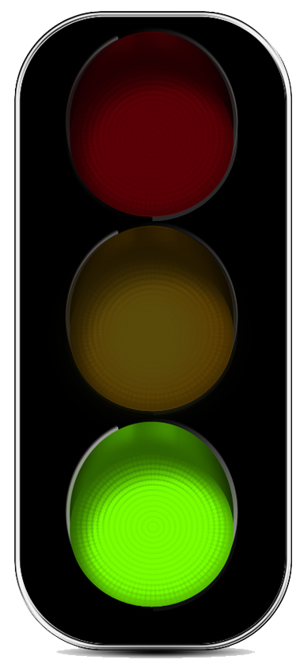
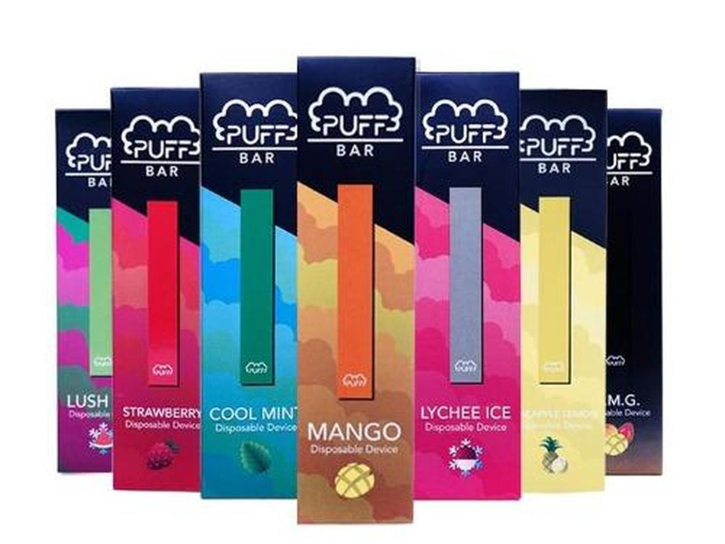
WHAT Can you buy?
Pod - Disposable
Not refillable
Not rechargeable
One time use and throw away

Slide 20
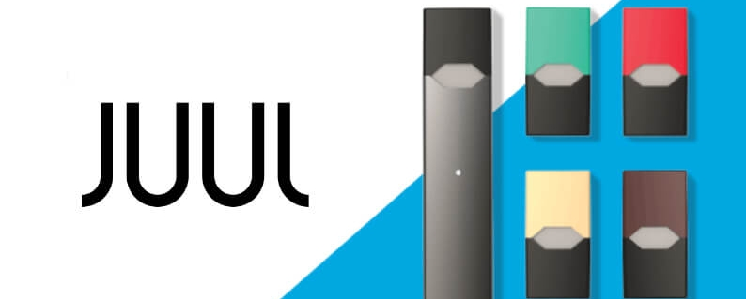
WHAT Can you buy?
Pod – Prefilled
One time use pods
Not user refillable
Rechargeable base

Slide 21
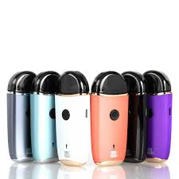
WHAT Can you buy?
Pod – Open – Disposable Pod
Pod can be filled by user
Pod can be refilled several times
Pod is disposable after several refills
Base can be recharged

Slide 22
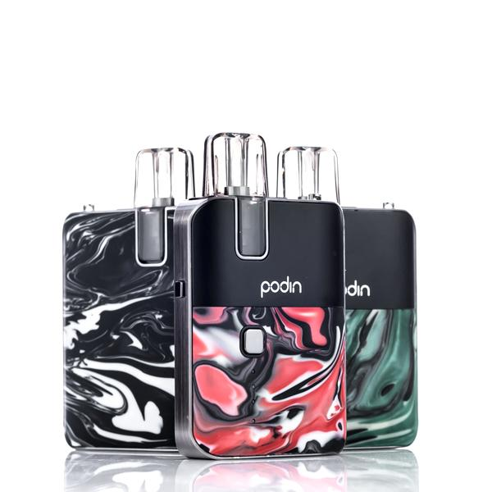
WHAT Can you buy?
Pod – Open – Replaceable Coil
Pod can be filled by user
Pod can be refilled several times
Pod is kept, but coil is replaced after several refills.
Base can be recharged

Slide 23
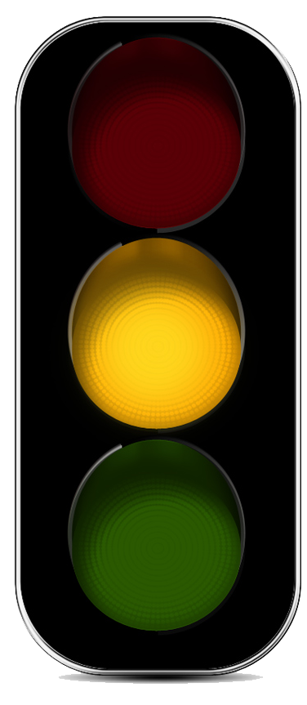
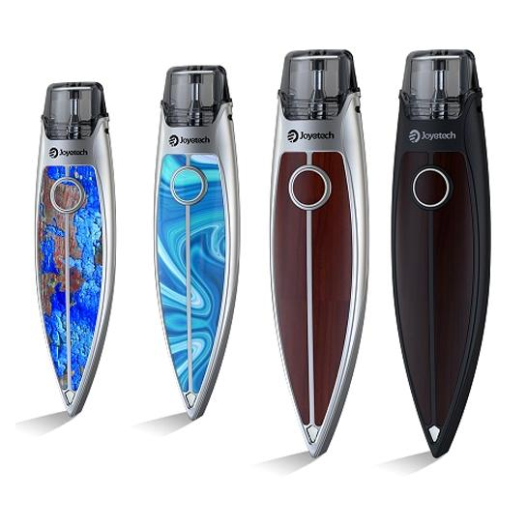
WHAT Can you buy?
Pod – Nic salt only
Doesn't have the power to create a satisfying throat hit with freebase nic or requires higher nic strengths (18mg+) to create a satisfying TH. Good for nic salts e-liquids

Slide 24
WHAT Can you buy?
Pod -Nic salt and freebase
Has the power to provide a satisfying throat hit using freebase e-liquid at a minimum of 12mg

Slide 25
WHAT Can you buy?
Pod – Non-adjustable
Single power only – no adjustment possible

Slide 26
WHAT Can you buy?
Pod – Semi-adjustable
A few power selections
Two or three settings
Not adjustable via wattage

Slide 27
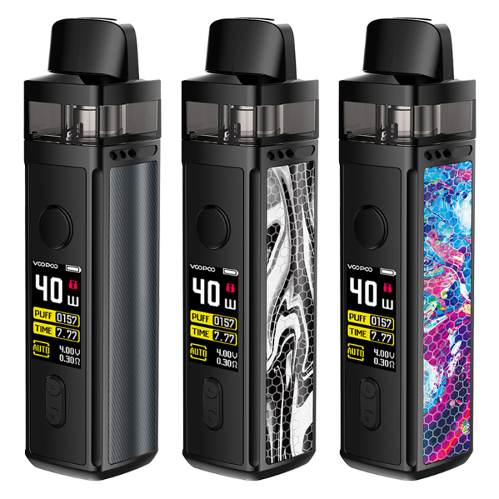
WHAT Can you buy?
Pod – Fully-adjustable
Can adjust in watts

Slide 28
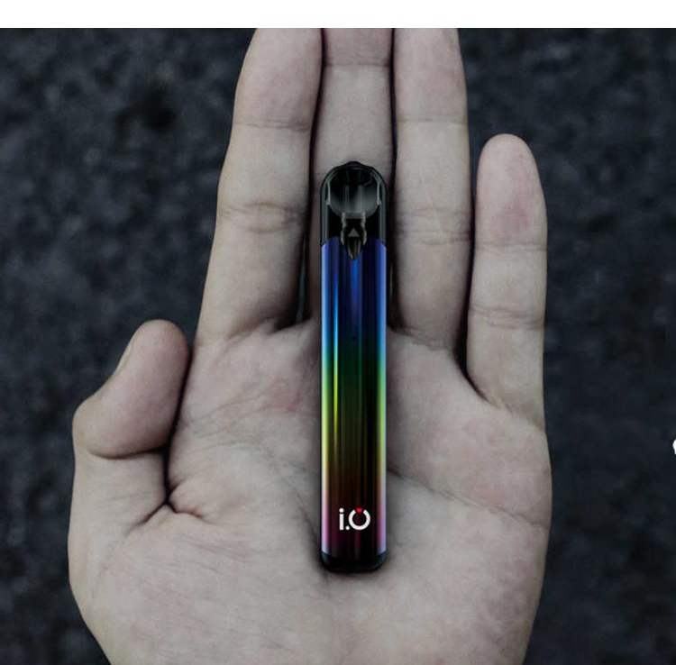
WHAT Can you buy?
Pod –Non-adjustable airflow
Cannot adjust the tightness of the draw

Slide 29
WHAT Can you buy?
Pod – Adjustable airflow
Can adjust the tightness of the draw

Slide 30
WHAT Can you buy?
Pod –MTL
Pod that works best for MTL (Mouth To Lung)
Most cigarette-like draw

Slide 31
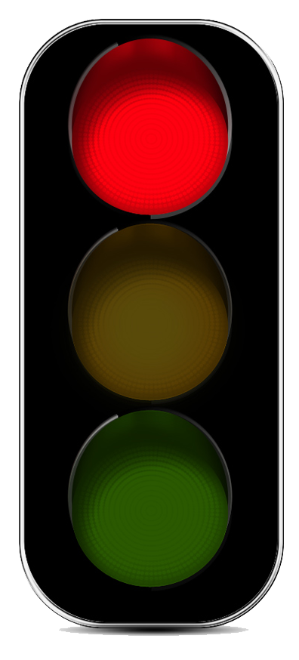
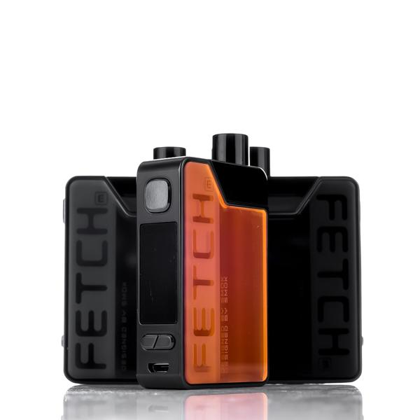
WHAT Can you buy?
Pod –RDL/DL
Pod that works best for RDL or DL (Restricted Direct Lung or Direct Lung)

Slide 32
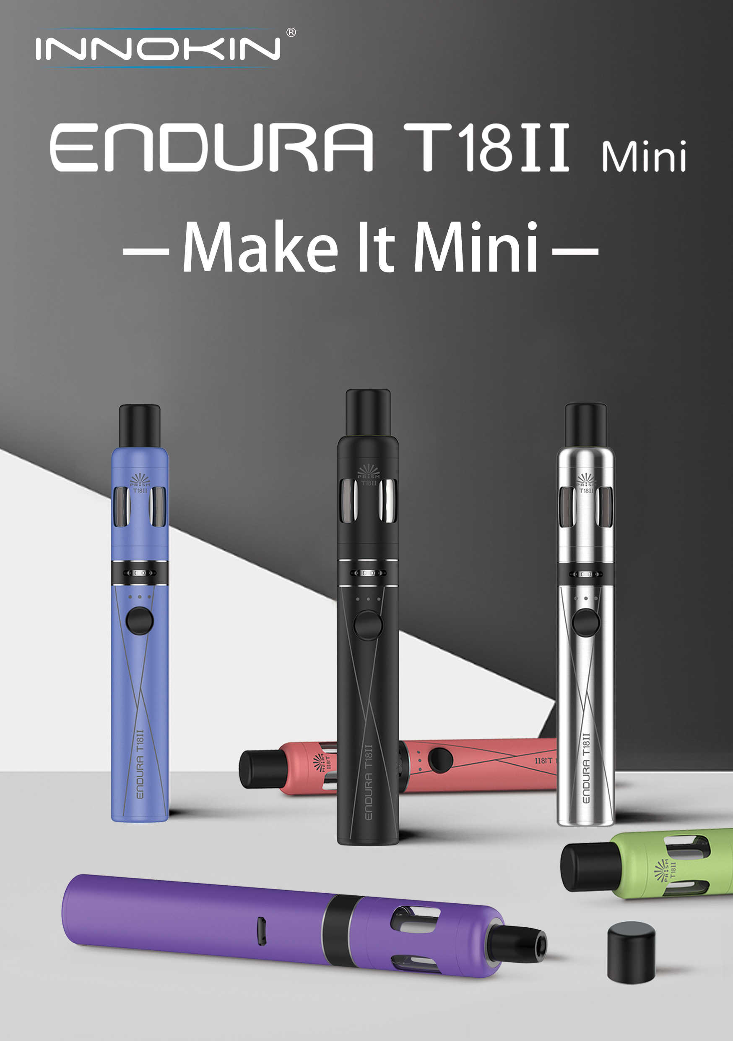
WHAT Can you buy?
Device – Tube
Cylindrical
Many different sizes

Slide 33
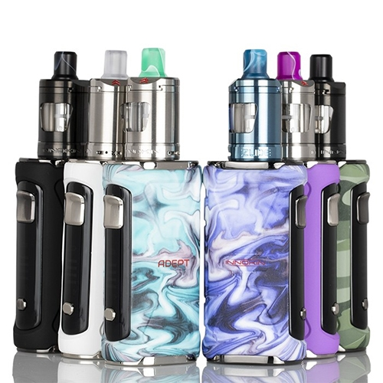
WHAT Can you buy?
Device – Box
Not cylindrical
Many different sizes and shapes

Slide 34
WHAT Can you buy?
Device - Internal batteries
The device contains an internal battery that cannot be replaced by the user.
The device can be charged via a USB cable.

Slide 35
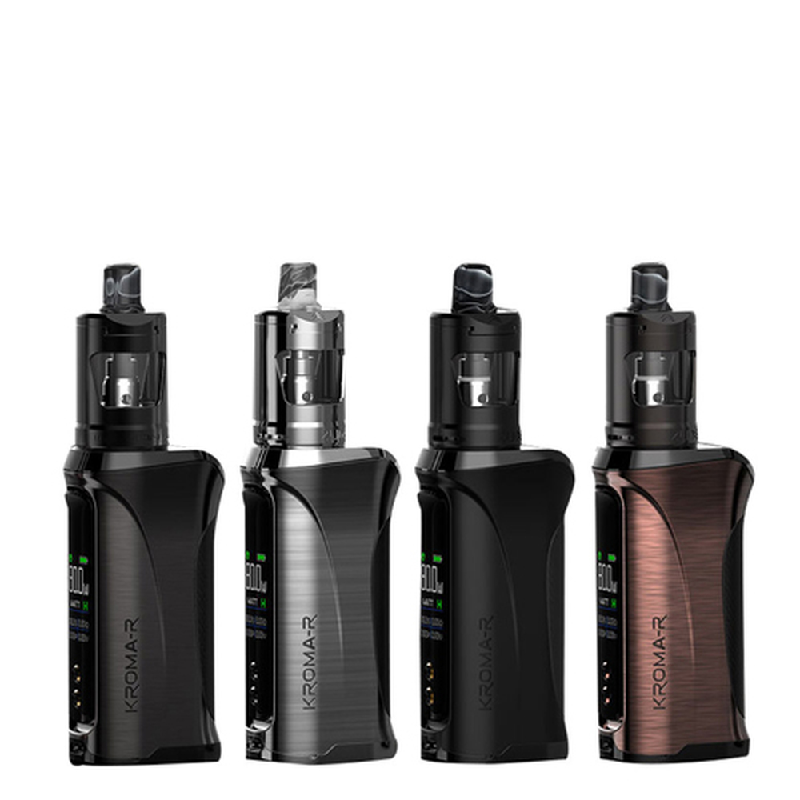
WHAT Can you buy?
Device - External batteries
The device uses external batteries.
Batteries can be removed and replaced by the user.
Batteries can be removed and recharged in an external smart charger.
Some external battery devices still have internal chargers.

Slide 36
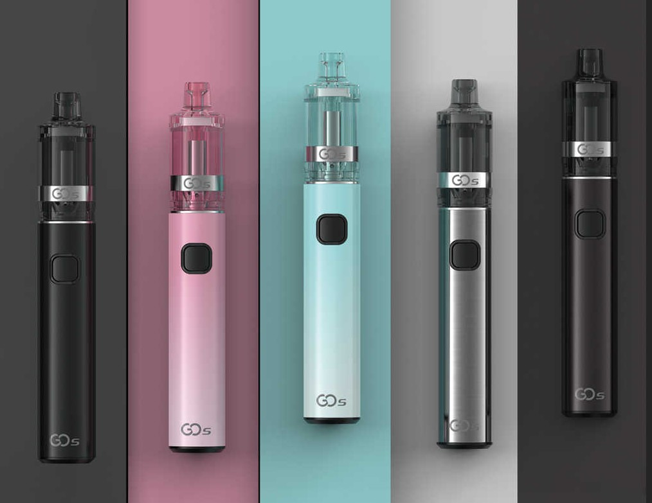
WHAT Can you buy?
Device – Non-adjustable
The device has no power adjustment.
Typically designed for its own atomizer/resistance combination.

Slide 37
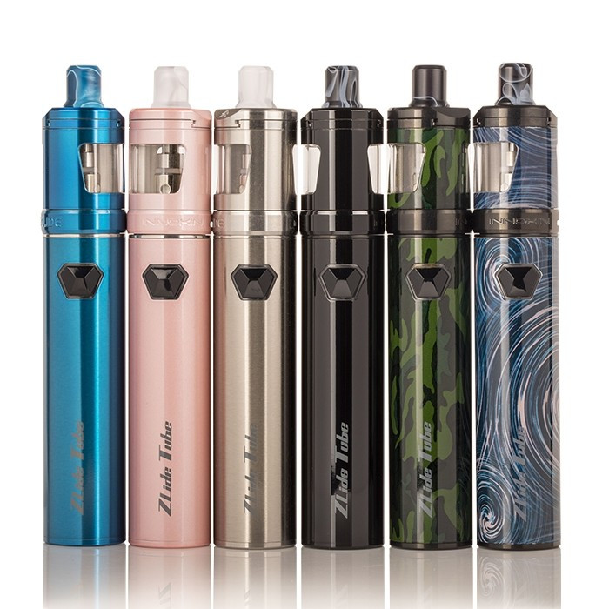
WHAT Can you buy?
Device – Self-adjusting
The device automatically adjusts based on the resistance of the attached atomizer.

Slide 38
WHAT Can you buy?
Device – Semi-adjustable
Will have a few settings.
Not fully adjustable via wattage.

Slide 39
WHAT Can you buy?
Device - Fully adjustable
Can be fully adjusted in wattage

Slide 40
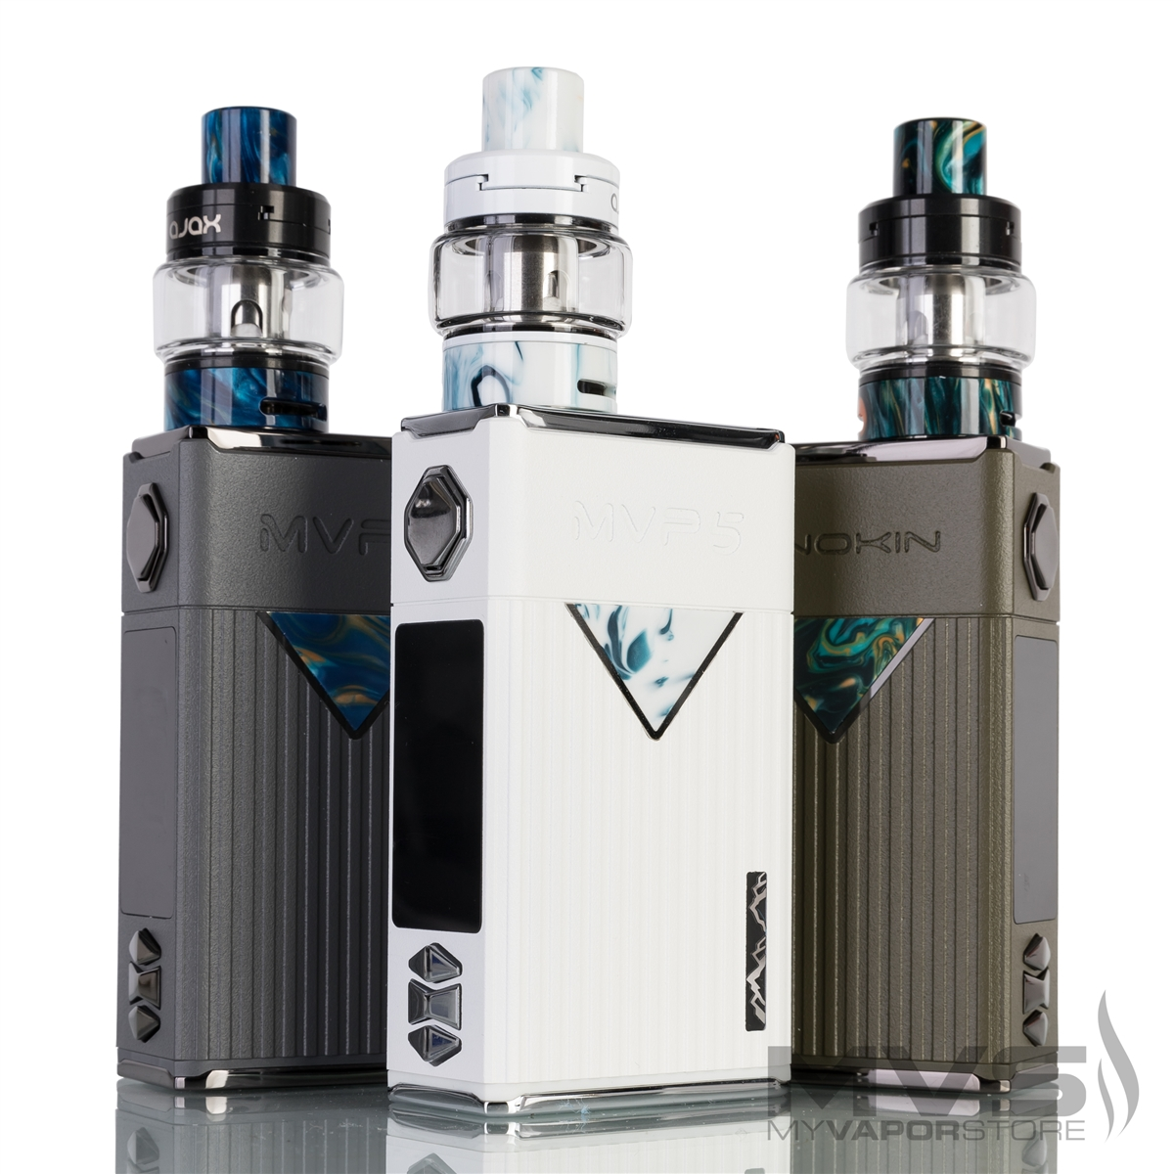
WHAT Can you buy?
Device - Fully featured
Will include all the features currently available in the vaping today such as:
Adjustable Wattage
Temperature Control
Custom Curves
Clock
Menu
More

Slide 41
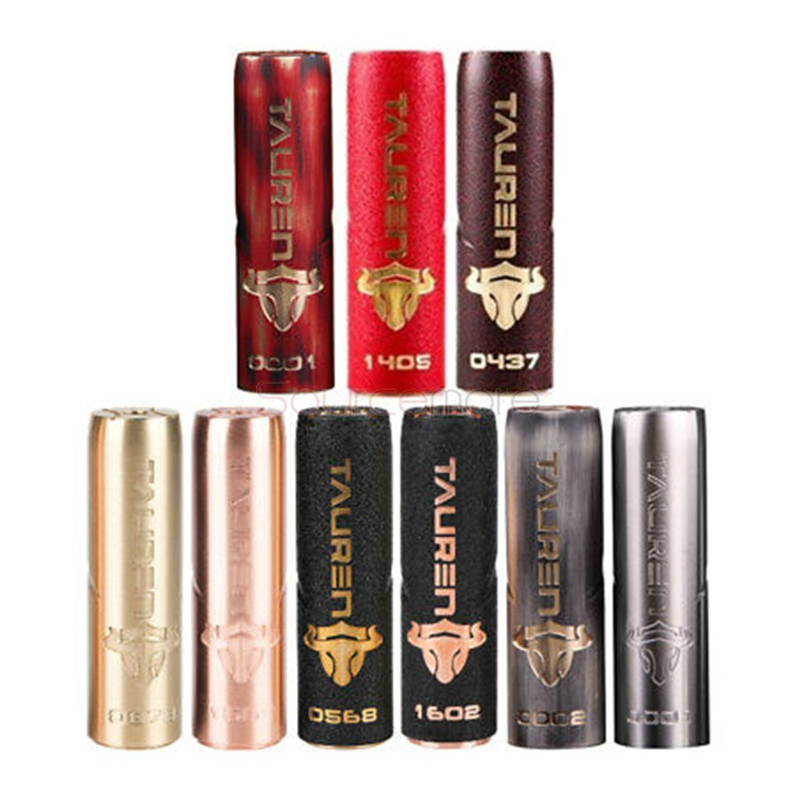
WHAT Can you buy?
Device –Mechanical
Direct connection between the battery and the atomizer.
No safety circuitry.
Not recommended for beginners.

Slide 42
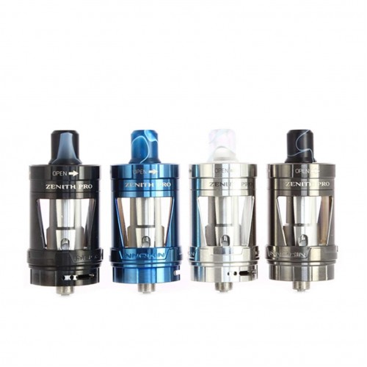
WHAT Can you buy?
Atomizer – Tank
Refillable tank that holds E-liquid

Slide 43
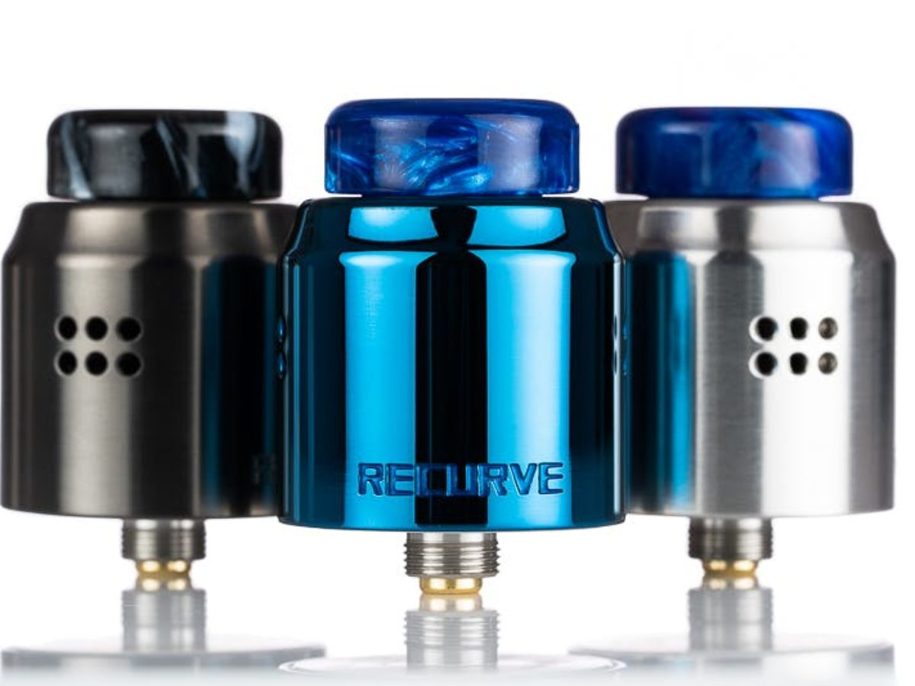
WHAT Can you buy?
Atomizer – Dripper
Holds very small amount of liquid.
User must constantly drip liquid into the atomizer.
Typically rebuildable

Slide 44
WHAT Can you buy?
Atomizer – Squonk
Holds very small amount of liquid.
Atomizer is fed e-liquid through a bottle contained in the device.
Also known as bottom feeding.
Many drippers can be converted to bottom feeding/Squonking atomizers.
Typically rebuildable

Slide 45
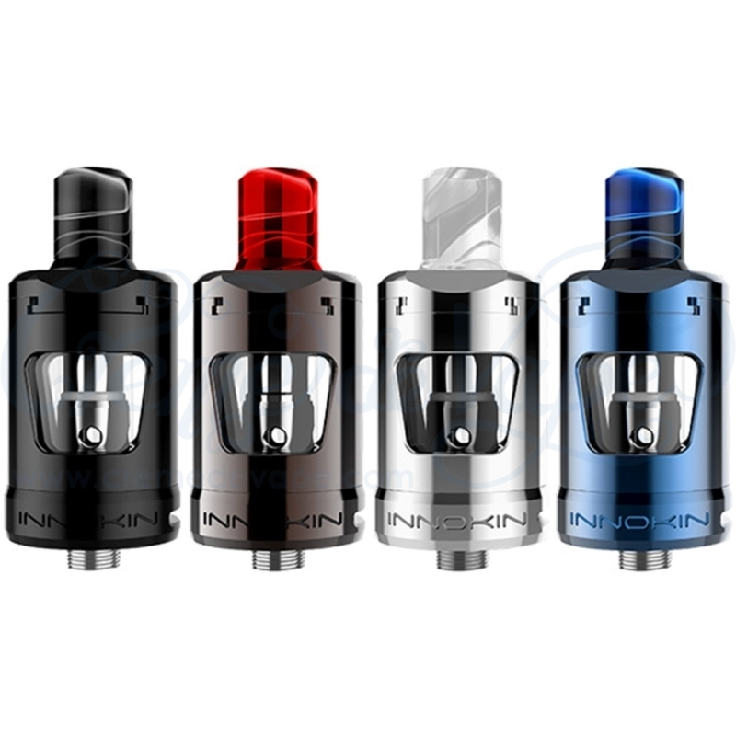
WHAT Can you buy?
Atomizer - User replaceable coils
The user can open the atomizer and replace the coil head when it wears out.

Slide 46
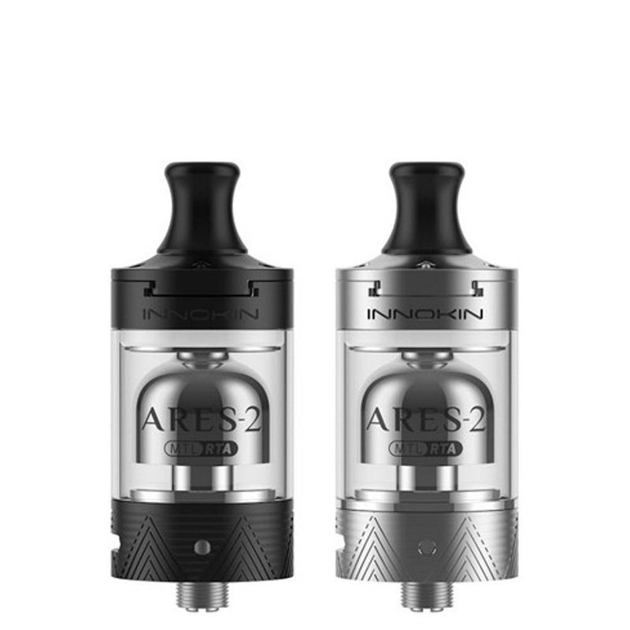
WHAT Can you buy?
Atomizer – Rebuildable
The user must create and install the heating coil and the wicking.

Slide 47
WHAT Can you buy?
Atomizer – MTL
Atomizer that works best for MTL (Mouth To Lung)
Most cigarette-like draw

Slide 48
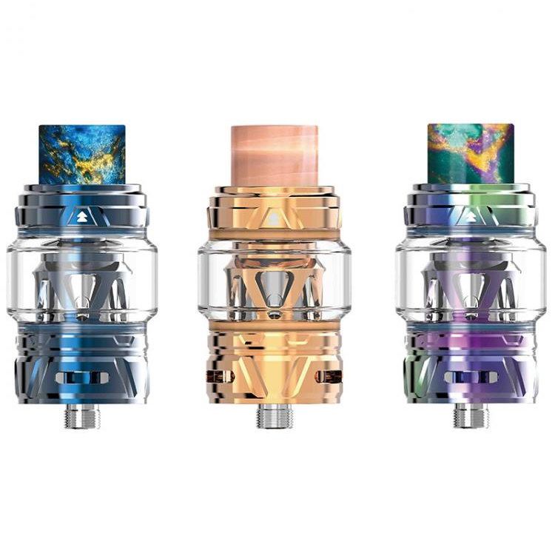
WHAT Can you buy?
Atomizer – DTL/DL
Atomizer that works best for RDL or DL (Restricted Direct Lung or Direct Lung)

Slide 49
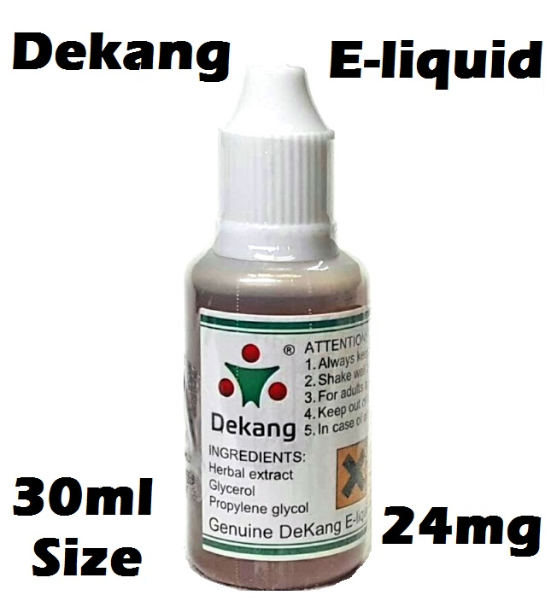
WHAT Can you buy?
E-Liquid – Freebase
The original type of nicotine e-liquid
Harsh at higher nic strengths
Provides good throat hit

Slide 50
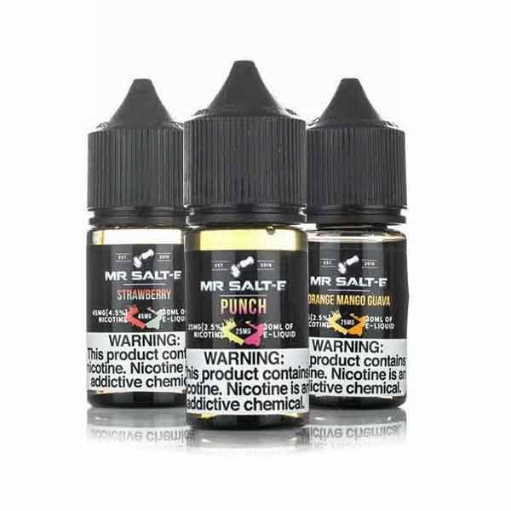
WHAT Can you buy?
E-Liquid – Salt
Newer type of e-liquid
Smooth at higher nic strengths
Provides little throat hit

Slide 51
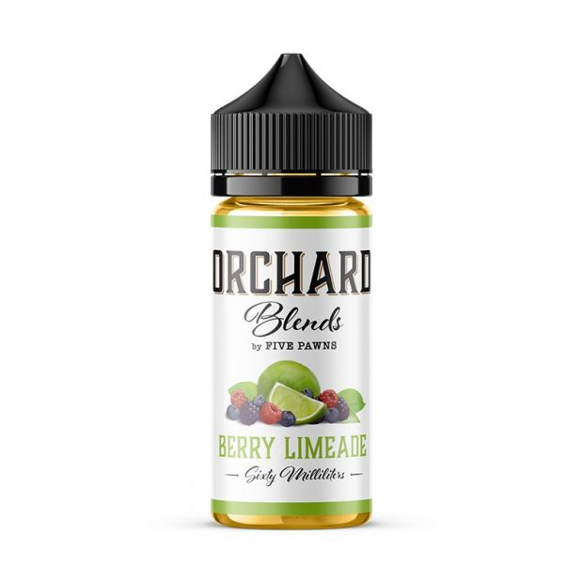
WHAT Can you buy?
E-Liquid - Synthetic Nic
Synthetic Nicotine has been around for a while
Some companies using it to get around laws
Inconsistent throat hit experiences
Expensive

Slide 52
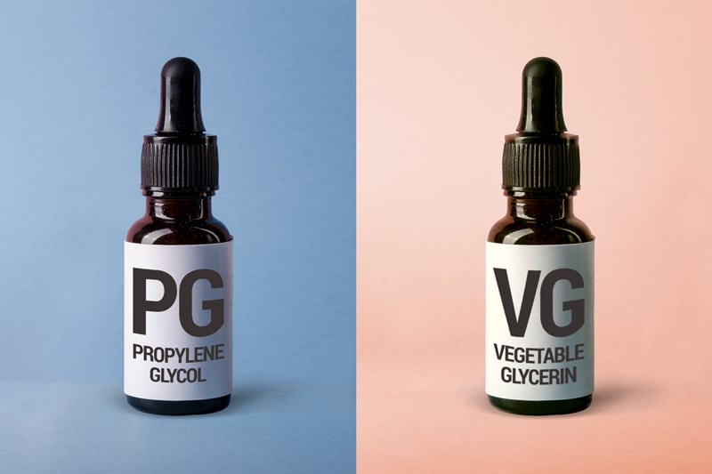
WHAT Can you buy?
E-Liquid - PG/VG Ratio
PG/VG Ratio described the percentage of each used in the liquid.
Higher PG
Thinner
Less dense vapor
Typically more throat hit
Typically requires less concentration of flavorings
Easier to wick
Typically for MTL type atomizers and pod systems
Higher VG
Thicker
Denser vapor
Typically less throat hit/smoother
Typically requires higher concentration of flavorings
Harder to wick
Typically for sub-ohm and cloud type drippers and attys

Slide 53
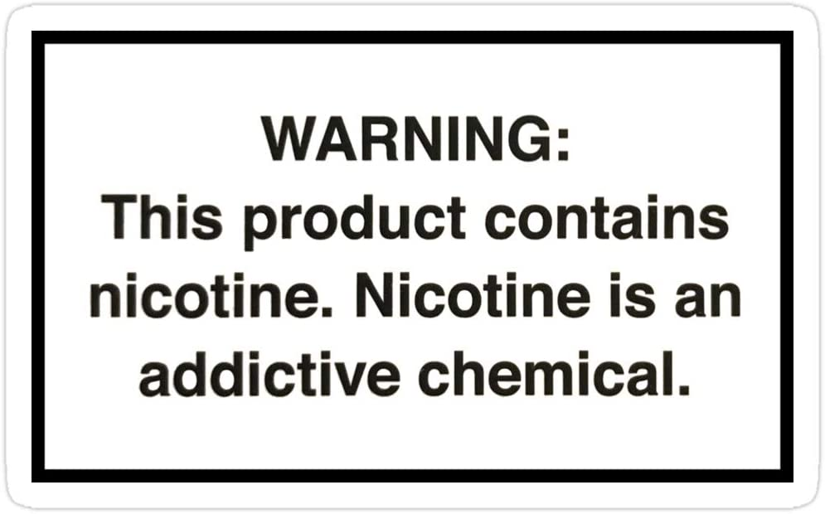
WHAT Can you buy?
E-Liquid – Nic strength
Typically provided in mg (Ex: 12mg) or % (Ex: 1.2%)
Described the amount of nicotine contained in the e-liquid.
Everyone is different
Less does not always = better
Nicotine + Experience = Success

Slide 54
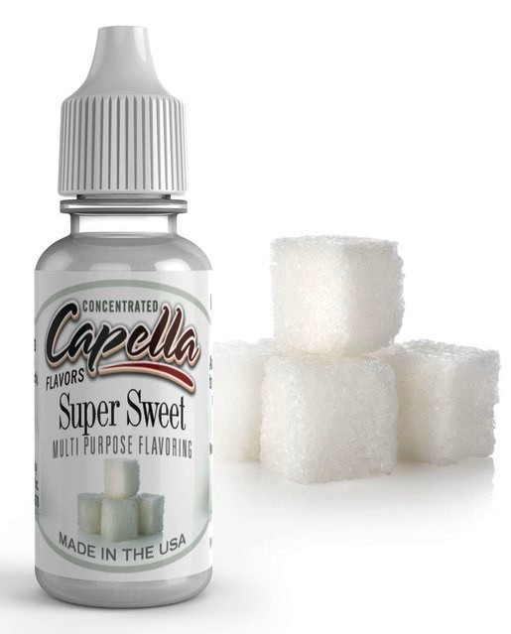
WHAT Can you buy?
E-Liquid –Sweeteners
Increase the sweetness of an e-liquid
Reduced coil life
Less needed for low power/temperature vaping

Slide 55
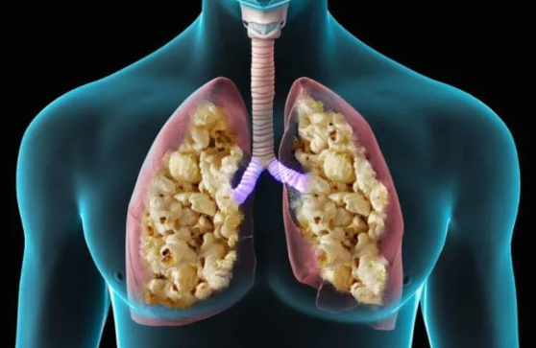
WHAT Can you buy?
E-Liquid – Diketones
Diacetyl, Acetyl Propionyl and Acetoin
Used to create creamy, buttery flavors
Known to cause “popcorn lung” in high doses
Some e-liquids don’t contain any.
If concerned ask.
Cigarettes known to have far higher doses even when compared to liquids that had higher concentrations.

Slide 56
COST OF VAPING VS. SMOKING
* Note - Some assumptions and generalities have been made
JUUL
Assumptions
Average Price for Juul = $34.99
Average Price for a Juul pod = $4
(2) Juul purchases per year
(1) Juul pod per day
$1,529.98 PER YEAR

Slide 57
COST OF VAPING VS. SMOKING
* Note - Some assumptions and generalities have been made
SMOKING
Assumptions
1 pack per day
Average price per pack $7.00
$2,500 PER YEAR

Slide 58
Hardware direction
Large vs. small device
Small Pros:
May be more attractive to a smoker due to size.
More convenient.
More pocket and purse friendly.
Small Cons:
Limited features
Limited adjustability
Limited battery life
Limited power

Slide 59
Hardware direction
Large vs. small device
Large Pros:
Feature rich.
Increased battery life.
Informational feedback due to screens.
Can grow and adjust with your vaping preference.
Large Cons:
May be less attractive to a smoker due to size.
Learning curve for features
Heavy and less pocket or purse friendly.

Slide 60
Hardware direction
Internal vs. external batteries (this choice mostly on medium to large devices)
Internal Pros:
Battery selection already made for you. You don’t have to figure it out.
No concern over battery covering wear.
Internal Cons:
Battery charge cycle life.
Cannot use external charger.
Cannot switch batteries when empty.

Slide 61
Hardware direction
Internal vs. external batteries (this choice mostly on medium to large devices)
External Pros:
Can use quality external smart charger.
Can switch batteries when empty.
Can choose battery you want.
External Cons:
Spare batteries must be properly protected.
Decision and confusion over which battery to use.
Battery cover wear over time. Must be aware of battery’s condition.

Slide 62
Hardware direction
All-In-One (AIO) vs. Traditional (510)
AIO Pros:
Typically easier to use.
Less parts.
System designed to work together.
AIO Cons:
Some are difficult to clean.
Typically less adjustable.

Slide 63
Hardware direction
All-In-One (AIO) vs. Traditional (510)
Traditional Pros:
510 connection gives the ability to use any tank with any device
Traditional Cons:
510 connection gives the ability to use any tank with any device

Slide 64
Liquid direction
E-Liquid Types
Standard vs. Salt.
PG/VG Ratio.
Nicotine Strength.
Flavor Profiles.

Slide 65
Liquid direction
Standard vs. Salt
Salt typically has higher nicotine strengths.
Salt is smoother with less throat hit.
Salt requires less power.
More addictive???
Standard has more “kick” when it comes to throat hit
Standard typically has more PG/VG ratio choices

Slide 66
Liquid direction
PG/VG Ratios
Higher PG
Carries flavor better.
Less vapor.
More throat hit.
Wicks easier (thinner).
Higher VG
Requires more flavoring.
Less throat hit.
More vapor.
Harder to wick (thicker).

Slide 67
Liquid direction
Nicotine Stregnth
0, 3, 6, 12, 18 (standard)
20, 50 (salt)
“Every American tobacco cigarette contains about 9 mg, but cigarette smoking burns away a lot of the nicotine. On average you’re inhaling about 1 mg of nicotine per tobacco cigarette. Therefore, a teaspoon of 12 mg e-liquid is equal to about 60 cigarettes.”
“The average, is about 12 mg per cigarette. The large majority of cigarettes fall between a range of 8 mg and 20mg.”

Slide 68
THE NEXT SMOKER’S SHOW TUESDAY, February 26th
SPECIAL GUEST AARON BIEBERT!!
To discuss & answer questions about hit new film:
“You Don't Know Nicotine - Documentary Film”
KICK STARTER FOR THE FILM (ends on Feb 25):
http://bit.ly/YouDontKnowNicotine

Slide 69
How does it work? (Covered in all episodes)
Most vaping products work the same way and contain the same components:
Power source – this component provides power to the heating element which boils the e-liquid creating the vapor.
Heating element – this component accepts power from the power source and heats the e-liquid to the boiling point creating the vapor.
Wicking – this component creates the “highway” which transfers the e-liquid to the heating element.
E-liquid – this component is boiled by the heating element and creates the vapor which you breath in.

Slide 70
Common terms (See episode #1)
You will run into many terms and acronyms when it comes to vaping. Here are a few of the more important ones.
510 – in vaping, the main connection type between the device and the atomizer.
Atomizer (Atty) – something you attach to a device or mod. It will contain the heating element, wicking, and e-liquid. There are many types:
Rebuildable – you install your own heating coil and wicking
RBA – Rebuildable atomizer
RDA – Rebuildable dripping atomizer
RTA – Rebuildable tank atomizer
RDTA – Rebuildable dripping tank atomizer
Replaceable – contains a user replaceable coil head
Coil – the main type of heating element. There are many different kinds of coil materials:
Nichrome – typically used in wattage mode, but can also be used in temperature control.
Kanthal – used only in wattage mode.
Stainless steel – can be used in wattage or temperature control modes.
Titanium – typically used in temperature control mode only.
Nickel – used only in temperature control mode.
Device or “mod” – a power supply for use with an atomizer – can contain user-replaceable or non-user-replaceable (internal) batteries.
Mechanical – a vaping device containing no circuitry, regulation, or safety. Should be used by experienced and knowledgeable vapers only.
Regulated – contains circuitry and safety features. A regulated device may or may not allow you to adjust your settings.
Dripping – dripping when using an RDA requires you to manually drip the liquid into the atomizer to keep the wick wet.
Resistance – heating elements come in different resistances. Differences here will affect performance, power requirements, vape temperature, responsiveness, and more.
Squonking – the act of pressing or squeezing a bottle contained in your device. This will inject e-liquid up into your atomizer. This requires an atomizer capable of being bottom fed. It’s like dripping, only upside down.
Sub-Ohm – a coil less with a resistance less than 1Ω.
Throat hit – the sensation or “thump” you feel in the back of your throat when vaping. This simulates the same sensation when smoking.
Watt – a measurement of power delivered to the heating element.

Slide 71
Vaping myths – Debunked (See Episode #1)
Vaping is just as or more harmful than smoking
Many studies including one from the Royal College of Physicians estimate vaping to be 95% safer than traditional combustible tobacco cigarettes.
The vapor contains formaldehyde
This information was based on a invalid study where unrealistic testing conditions produced “dry puffs” and thus meaningless results.
E-liquid contains antifreeze
This information was based on a 2009 study where 18 e-liquid cartridges were tested and one contained diethylene glycol, a chemical used in industrial antifreeze that is toxic to humans. The level found was nearly untraceable at around 1%. This should not be a concern with modern e-liquid manufacturing practices & techniques from reputable companies.
E-liquids do contain propylene glycol (PG), which is sometimes used in antifreeze as an additive to make it less dangerous if swallowed. The Food and Drug Administration (FDA) has classified PG as an additive that is "generally recognized as safe“ for human consumption.
Nicotine is bad for you
Nicotine, while certainly addictive, is not carcinogenic and has never been linked to cancer. Outside of that, there are debates as to the good and bad of nicotine:
THE GOOD - Nicotine consumption may increase the speed of sensory information processing, relieve stress, anxiety, and panic attacks, and more.
THE BAD - Nicotine is a stimulant, much like caffeine. Nicotine can kick start your adrenal glands and give you a bit of adrenaline. Nicotine can cause a short term increase in heart rate and blood pressure but only temporarily, same as your coffee.

Slide 72
Vaping myths – Debunked (continued) (See Episode #5)
Teens inhaling cancer causing chemicals
See video: https://www.youtube.com/watch?v=gEZnsgz_stM

Slide 73
I WANT TO QUIT SMOKING!
Recommended Methods – Desirable to Least Desirable
Cold Turkey – JUST QUIT!
Traditional Methods – Patches, Gums, Medications
Vaping – Via Traditional Nic liquids
Vaping – Via Salt Nic liquids
ALWAYS REMEMBER - Vaping is not harm elimination! Vaping is harm reduction! The safest way to vape is to not vape at all.

Slide 74
Styles
Mouth To Lung (MTL) – The act of bringing the vapor into your mouth first, then inhaling it into your lungs. 99% of smokers use the MTL style when using a cigarette. Typically a tighter draw more similar to that of a cigarette.
Direct Lung/Lung Hitting (DL) – the act of taking the vapor from the EVP directly into your lungs. If you’ve ever smoked those funny looking cigarettes back in your college days, you’re familiar with “Direct Lung” inhales. Typically a looser draw.
Note: Although these are the two major styles of vaping, there are certainly ranges and draw resistances within each style, such as “restricted direct lung” (RDL). Airflow controllers and different types of atomizers and devices allow you to find what is best and most comfortable for you.

Slide 75
What DO I Have to do?
Closed POD type systems
Charge, replace pods
Open POD type systems
Charge, fill pods, replace pods
All-In-Ones
Charge, fill e-liquid, replace coil heads, clean
Tanks (replaceable coil heads)
Fill e-liquid, replace coil heads, clean
Tanks (rebuildable)
Create and install build, wick, replace wick, replace coil, fill with e-liquid, clean

Slide 76
What DO I Have to KNOW? (Bare Minimum)
What is E-liquid (Juice)?
The liquid that is heated, turned to vapor, and inhaled into your lungs
Contains PG/VG/Nic/Flavors
Higher VG will produce more vapor, less throat hit, and will be more difficult to wick (thicker)
What is mAh?
mAh is the capacity rating of the battery. Higher mAh will give you more vape time on a charge
What is resistance (Ohms/Ω)
Coils come in different resistances and materials. An Ohm is a measurement of that resistance. When current is run through the coil, it will heat because of it’s resistance.
Higher resistance coils require lower power levels.
Higher resistance coils will create a cooler vape.
Lower resistance coils require more power.
Lower resistance coils will create a warmer vape.
What is Mouth To Lung (MTL) Vs. Direct Lung (DL)
The two main styles of vaping
MTL is how most people will smoke a cigarette, first taking the smoke into their mouth and then into their lungs.
DL is the act of taking the vapor directly into their lungs
What is wattage?
Wattage is the “volume control” of adjustable E-liquid Vaping Products. As you increase the EVP’s wattage, you increase the power to the coil making it hotter.

Slide 77
What are my consumables?
Closed POD type systems
The pod (already contains e-liquid)
Open POD type systems
The pod, e-liquid
All-In-Ones
E-liquid, coil heads
Tanks (replaceable coil heads)
E-liquid, coil heads
Tanks (rebuildable)
E-liquid, coils, wicking material

Slide 78
What’s in the liquid? (See Episode #2)
E-liquids will generally contain 4 main ingredients. Those ingredients are:
Propylene Glycol (PG)
PG is a colorless, odorless liquid. It’s used in the food industry as a flavoring carrier, an ingredient in food coloring, an additive in various medicines, and the active ingredient in asthma inhalers and nebulizers. Propylene Glycol is non toxic and is "generally recognized as safe“ for human consumption by the FDA in moderate quantities.
Vegetable Glycerin (VG)
VG is a colorless, odorless liquid derived from plant oils. Although it’s processed from oils, it isn’t an oil, but rather an alcohol which makes it safe to inhale. It’s used in the food industry as a sweetener and to keep foods moist. Medicines also contain VG. Vegetable Glycerin is non toxic and is "generally recognized as safe“ for human consumption by the FDA in moderate quantities.
Flavorings
E-liquid is flavored with food-grade flavorings.
Nicotine

Slide 79
Types of e-liquids (See Episode #2)
Higher PG
Produces less vapor.
Generally thinner and easier to wick.
Could be considered more “harsh” and provide more of a throat hit (TH). The nicotine concentration can also affect the amount of TH.
Higher VG
Produces more vapor.
Generally thicker and more difficult to wick.
Could be considered “smoother” with less of a throat hit. The nicotine concentration can also affect the amount of TH.
Salt-Nicotine E-liquids
A newer type of e-liquid that utilizes nicotine salts as apposed to the more standard freebase nicotine. The process used to create the nicotine salt creates a nicotine that is smoother with less TH and a faster absorption rate. This is good for those who require high nicotine levels to be successful with vaping. It’s also good for smaller, less powerful devices such as small pod systems.

Slide 80
Types of evps
There are now thousands of vaping products on the market. They can be broken down into a few different types:
Device or “Mod” – this is a power supply only. It requires an atomizer to operate.
All-In-One (AIO) – a device that incorporates the atomizer.
NOTE – Devices, mods, and AIOs come in different form factors such as tubes (sticks) or box formats.
Open systems – these products allow you to open and refill the product with your own e-liquid.
Closed systems – these products do not allow you to refill them. Once emptied of e-liquid, you will generally need to purchase a new tank or “pod”
Disposable – these are one time use products. Once emptied of e-liquid, they are designed to be thrown away.
Features – Feature sets will vary by devices. Some will have none, some will have many. Here is a sample of features you will run into:
Adjustability (wattage and temperature)
Temperature Control
Custom Curves
Firmware Upgradeability
Information screens (black and white & color)
Custom TCR Values (Temperature Coefficient of Resistance) – Used with temperature control
Date/Time features

Slide 81
Types of COILS (See Episode #2)
You will hear the term “coil” many times in vaping but it can mean different things:
Coil Head: this is a pre-built coil encapsulated in an enclosure with wicking included. This is for use in a “replaceable” atomizer. They will typically screw in and out of an atomizer and are usually proprietary to the atomizer they are made for. They will come in different configurations, materials, and resistances.
Build your own: this is when you use raw wire to create your own coil or heating element. It will also need to be wicked by you. This coil is used in a “rebuildable type atomizer such as:
RBA – Rebuildable atomizer
RDA – Rebuildable dripping atomizer
RTA – Rebuildable tank atomizer
RDTA – Rebuildable dripping tank atomizer
Pre-Built: The coil has already been created for you for use in one of the “rebuildable” type atomizers listed above. You will also need to wick this type of coil.
Coil materials, prebuilt, and coil heads can come in numerous materials, types, resistances, gauges, configurations, and styles.
Sample materials - Kanthal, stainless steel, nickel, titanium, nichrome
Sample types – round, flat, mesh
Sample resistances – 1.5ohm, 1ohm, .8ohm, .4ohm
Sample gauges – 28g, 26g, 24g
The higher the number, the thicker the wire and the lower the resistance per inch.
Sample configurations – Single, dual, quad, touching, spaced
Sample styles – Twisted, Clapton, Fused Clapton, Staggered Clapton, Tiger, Alien, Helix, Zipper, etc.
These may also be considered “exotic” coils. They style names represent how single core wires have been twisted and weaved together.

Slide 82
Types of TANKS (see episode #3)
Here is a further breakdown of the type of tanks you’ll come across in vaping.
Styles – Tanks will fall in to the following vaping styles. Some tanks can be used across multiple styles:
MTL – Mouth to lung
DL – Direct to lung
RDL – Restricted direct lung
Filling – Tanks can be filled in a variety of ways:
Top fill
Bottom Fill
Side Fill
Dripped
Squonked
Types – Tanks will fall into to main categories with sub-categories of each:
Replaceable – contains a user-replaceable coil head
Rebuildable (RBA) – the user much build their own coil (or use a pre-built coil) and install and wick it themselves. There are many different kinds of rebuildable tanks:
RTA – Rebuildable tank atomizer
RDA – Rebuildable dripping atomizer
RDTA – Rebuildable dripping tank atomizer
GTA – Genesis tank atomizer
BF – Bottom Feeding (Squonking)
Pod – pods are types of tanks that contain the coil and wicking. They are typically sealed and do no give you access to the coil or the wicking material. At the moment, there are no rebuildable pods. They are generally created for one-time or limited use. Some pods allow you to change the coils as seen on the Joyetech Dolphin. There are two main types of pods:
Open – They allow you to refill them with your own e-liquid.
Closed – These are one-time use pods that come prefilled with liquid. Once the liquid is out, the pod becomes disposable.

Slide 83
Welcome our Special guest! (See Episode #4)
JOHN MUCHOW AKA “BATTERY MOOCH”
ECF Blog - https://www.e-cigarette-forum.com/blogs/mooch.256958/
Facebook - https://www.facebook.com/batterymooch/
Reddit - https://www.reddit.com/user/mooch315
YouTube - https://www.youtube.com/channel/UCePHh3NMvu3rW2LFJeOWo-Q
Instagram - batterymooch

Slide 84
COST OF VAPING VS. SMOKING
* Note - Some assumptions and generalities have been made
SMOKING
Assumptions
1 pack per day
Average price per pack $7.00
$2,500 PER YEAR

Slide 85
COST OF VAPING VS. SMOKING
* Note - Some assumptions and generalities have been made
AVERAGE DIRECT LUNG
Assumptions
SMOK I-Priv kit w/ TFV12 Tank = $57.99 (MVS)
TFV Coil = $4.66 per coil (MVS)
60ml Naked E-Liquid Bottle = $18.99 (MVS)
(2) kits per year
(1) coil per week
(2) 60ml E-liquid per week
$2,333.26 PER YEAR

Slide 86
COST OF VAPING VS. SMOKING
* Note - Some assumptions and generalities have been made
JUUL
Assumptions
Average Price for Juul = $34.99
Average Price for a Juul pod = $4
(2) Juul purchases per year
(1) Juul pod per day
$1,529.98 PER YEAR

Slide 87
COST OF VAPING VS. SMOKING
* Note - Some assumptions and generalities have been made
JUNO
Assumptions
Average Price for Juno* = $24.95
Average Price for a Juno pod = $4
(2) Juno purchases per year
(1) Juno pod per day
$1,494.16 PER YEAR
*Prices found on electrictobacconist.com

Slide 88
COST OF VAPING VS. SMOKING
* Note - Some assumptions and generalities have been made
LEAP
Assumptions
Average Price for Leap* = $19.99
Average Price for a Leap pod = $4
(2) Leap purchases per year
(1) Leap pod per day
$1,493.38 PER YEAR
*Prices found on electrictobacconist.com

Slide 89
COST OF VAPING VS. SMOKING
* Note - Some assumptions and generalities have been made
AVERAGE OPEN POD
Assumptions
Innokin EQ = $24.99 (MVS)
Replacement EQ Pods = $3.99 per pod (MVS)
30ml Salt Bae E-Liquid Bottle = $17.99 (MVS)
(2) kits per year
(2) pods per week
(1) 30ml E-liquid per week
$1,400.42 PER YEAR

Slide 90
COST OF VAPING VS. SMOKING
* Note - Some assumptions and generalities have been made
AVERAGE MOUTH TO LUNG
Assumptions
Innokin Kroma Kit w/Zenith Tank = $49.99 (MVS)
Z-Coil = $2.50 per coil (MVS)
60ml Naked E-Liquid Bottle = $18.99 (MVS)
(2) kits per year
(1) coil per week
(1) 60ml E-liquid per week
$1,217.46 PER YEAR

Slide 91
COST OF JUUL E-LIQUID
JUUL E-LIQUID
JUUL Pod = .7ml of E-liquid
Average Price for a JUUL Pod = $4
Subtract $3 for cost of pod, coil, and filling (I’m being VERY conservative here)
JUUL E-Liquid = $1 per .7ml
Equivalent price for JUUL E-Liquid 30ml = $42.86
Equivalent price for JUUL E-Liquid 60ml = $85.71
STANDARD E-LIQUID
Price for Mr. Salt-E E-Liquid 30ml bottle from MVS = $14.99 = 65% savings over Juul E-Liquid
Price for Naked 100 E-Liquid 60ml bottle from MVS = $18.99 = 77.84% savings over Juul E-liquid

Slide 92
COST OF VAPING VS. SMOKING

Slide 93
Building
WHY BUILD?
Save money on pods and coil heads
Customize to your preferences and materials
Large selection of rebuildables on the market
Excellent flavor
Hobbyist/Enthusiast/Passion – Vaping can be more than just vaping
Possible bans

Slide 94
Building
WHAT YOU’LL NEED?
An RBA – RDA, RTA, RDTA
Cotton/Wicking Material
Wire
Tools
Resistance reader
Screwdrivers
Flush wire cutters (Micro Shear Flush Cutter with Lead Retainer)
Scissors
Ceramic Tweezers
Needle nose pliers
Patience! ☺

Slide 95
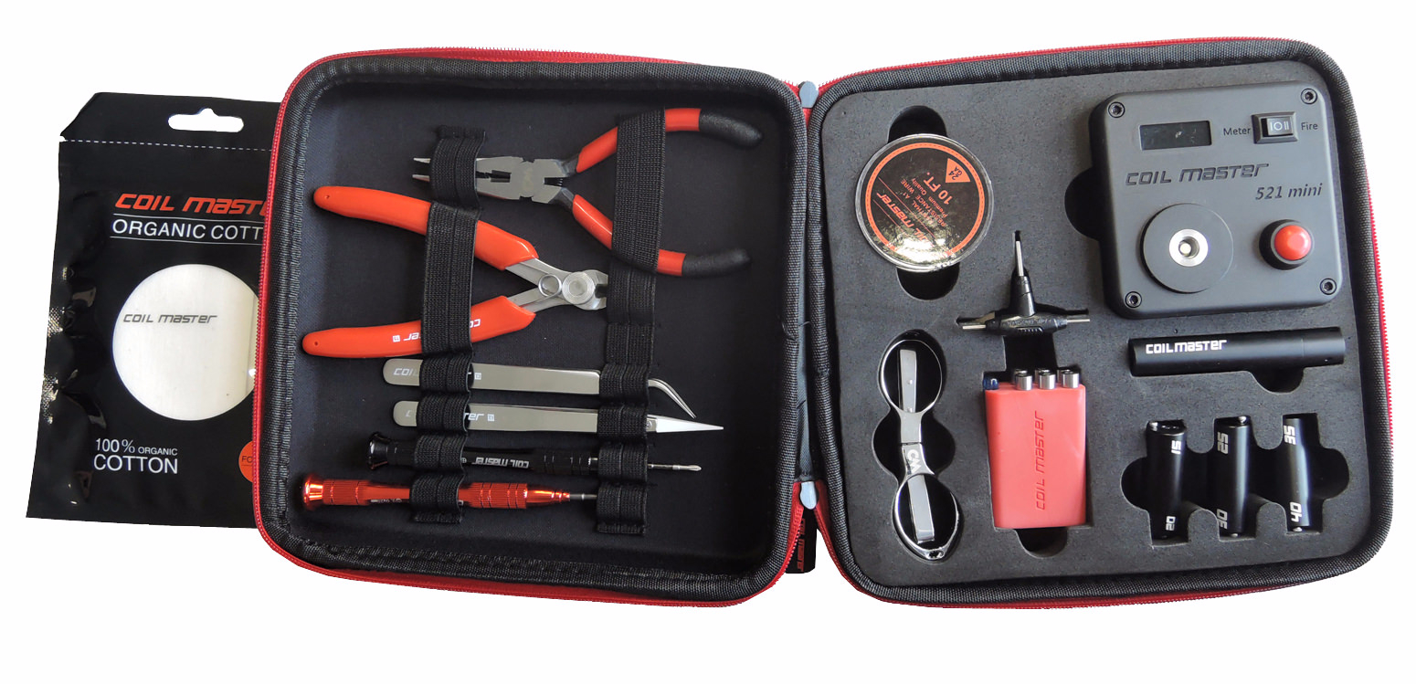
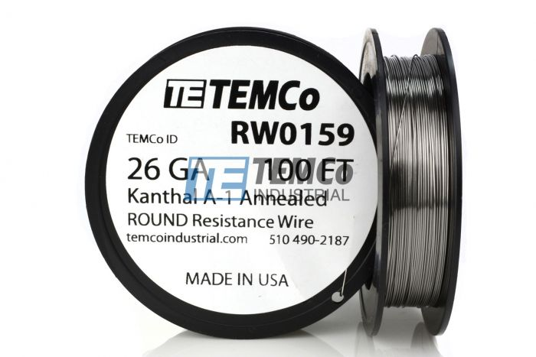
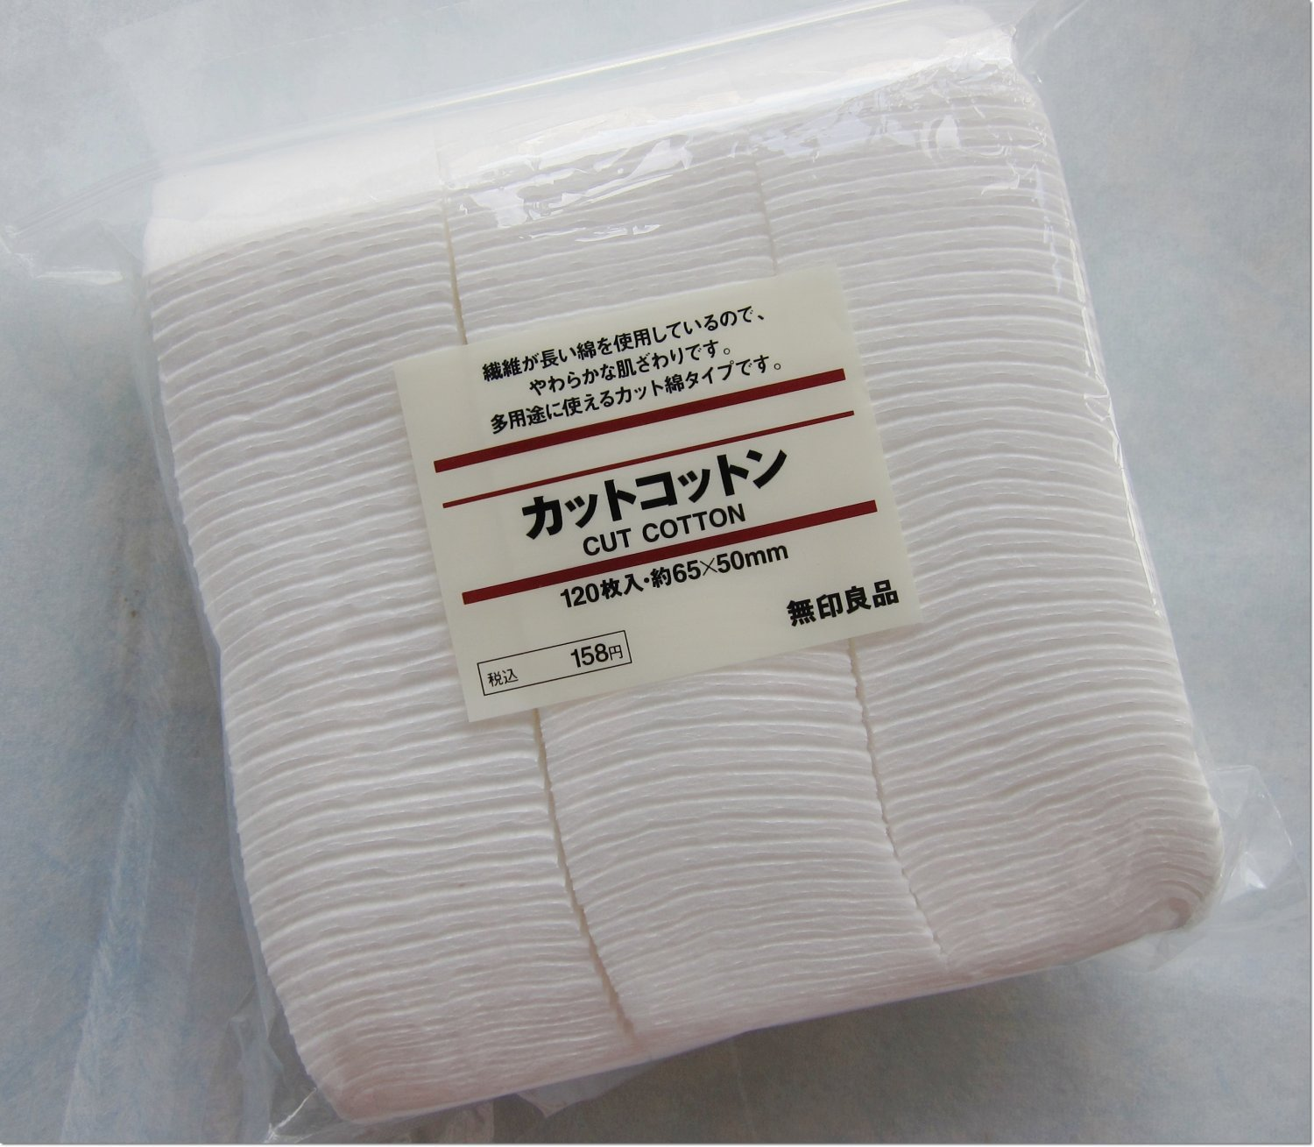
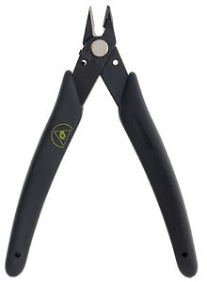
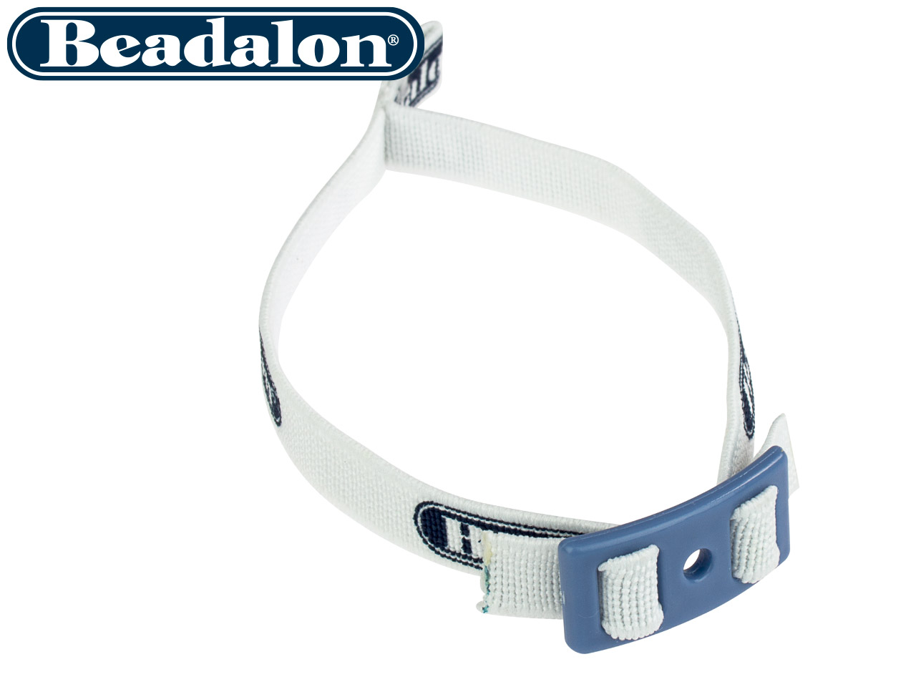
Building
SUGGESTIONS
Coil Master DIY Kit V3 - $43.99 from MyVaporStore
Wire – Specific for vaping OR Temco from Ebay
100ft 26 gauge Kanthal - $7.39
100ft 26 gauge SS316L - $5.95
Cotton – Specific for vaping OR Japanese Organic Unbleached Cotton – Amazon/Ebay
60 sheets Koh Gen Do – Amazon - $15.00
180 sheets Muji – Amazon – $6.48
Xuron - 410ASF Micro-Shear® Flush Cutter - $12.98 Ebay
Beadalon Artistic Wire SPOOL TAMER – Ebay - $12.35 for a 25-pack

Slide 96
Temperature control
More Coming Soon!

Slide 97
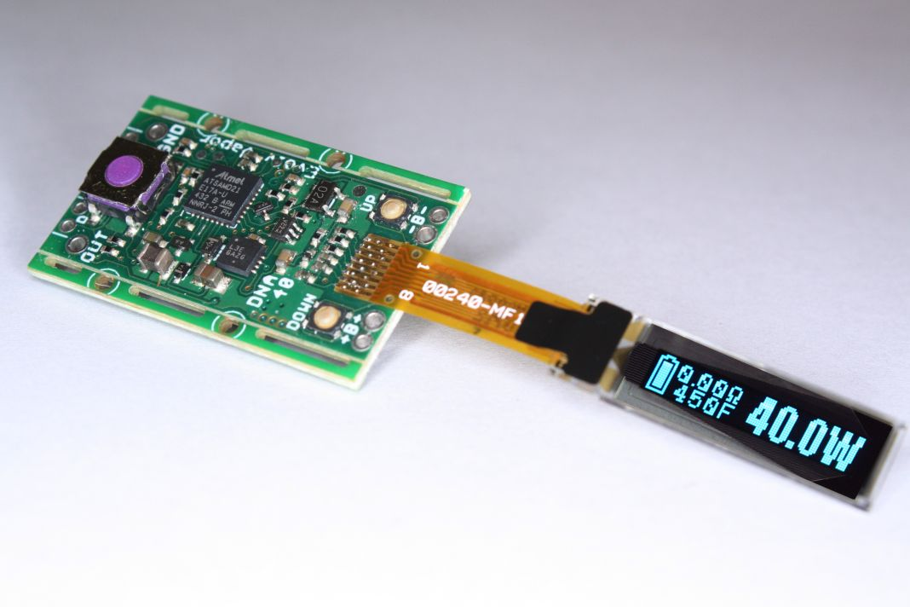
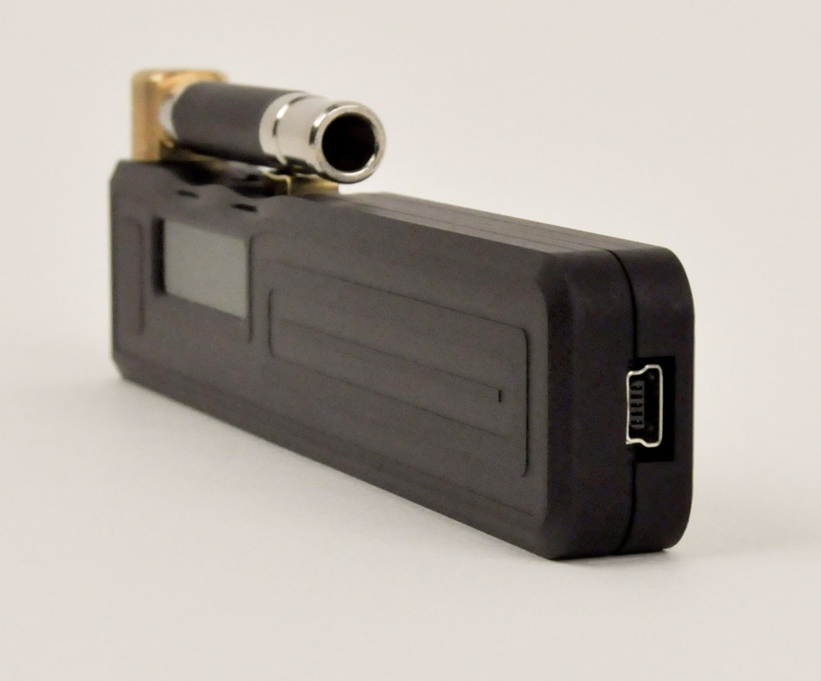
Temperature control
WHAT IS IT?
Introduced by Evolv (www.evolvapor.com) in 2014 it was a way to control the temperature of the coil for safety, consistency, and avoiding “dry hits”.
Original coil material to use temperature control was NI200.
First board to support Temperature Control was the Evolv DNA-40.
This is the second time Evolv has changed the vape scene. The first time was the introduction of the Darwin in 2010 which moved the industry away from adjusting in Voltage and moved to adjusting in Wattage. The Darwin was capable of 12.7 Watts maximum!

Slide 98
Temperature control
HOW DOES IT WORK?
Temperature control works by measuring the change of resistance in the coil as the coil heats up.
Knowing the starting resistance of the coil and the baseline temperature it’s able to assume the temperature of the coil based on the resistance increase.
This is why it’s very important to mate a cool atomizer with a cool mod when setting up for temperature control.
Since different wires resistance’s change differently as they heat up, this is why it’s important to set the wire on the device you’re using. (TCR – Temperature Coefficient of Resistance)

Slide 99
Temperature control
WHAT I INITIALLY THOUGHT ABOUT IT
Dry coil vaping in Vegas!
WOW!!!
Going to change everything!
Liquids with temperature recommendations!

Slide 100
Temperature control
WHAT I NOW THINK ABOUT IT
Difficult to use
Difficult to set-up
Inconsistent results over different devices and atomizers
Inaccurate
Not for beginners

Slide 101
Temperature control
WHAT ABOUT REPLAY?
Replay was introduced by Evolv in 2018 with the DNA75C and DNA250C
Why wasn’t it adapted?

Slide 102
Temperature control
WHY DO I CONTINUE TO USE IT?
Consistent vape
Fast ramp up without over shooting
No dry hits when tank is empty
Avoid bad stuff
Reduce “flavor creep” when changing flavors
Increase in coil and wick life

Slide 103
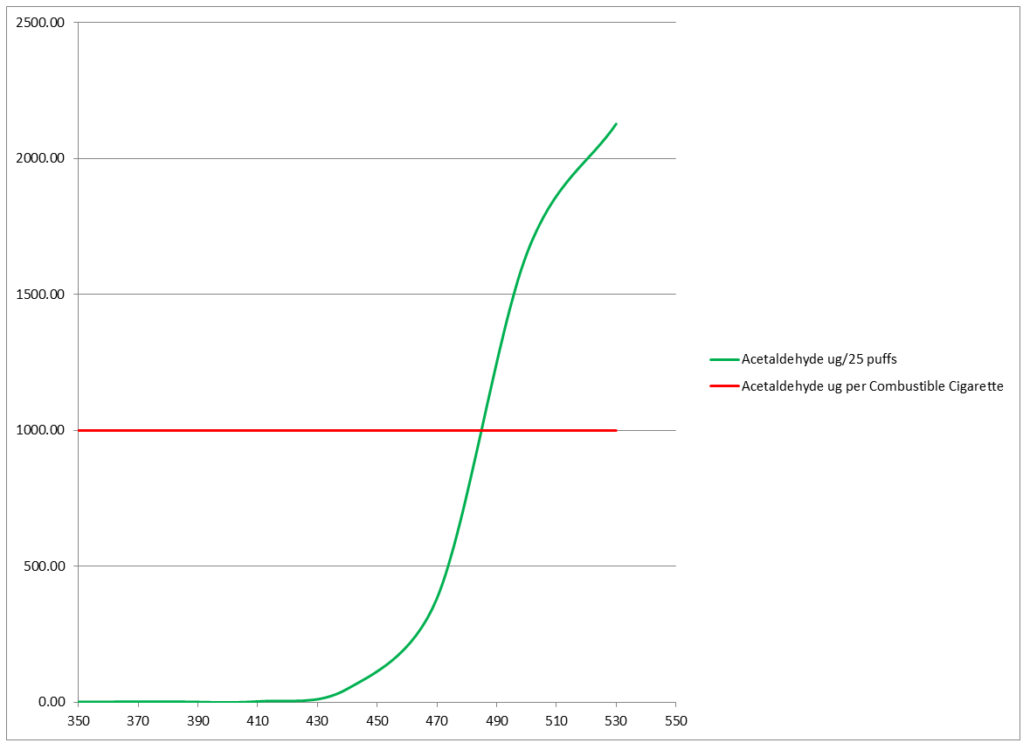
Temperature control
AVOID BAD STUFF?
“Acetaldehyde is a known human carcinogen. It is the least bad of the big three. The data for Formaldehyde and Acrolein (the second worst and worst things in the vape, by far) are even worse. ”
– Anonymous Source

Slide 104
Temperature control
FAST RAMP UP?

Slide 105
Temperature control
FAST RAMP UP?

Slide 106
Temperature control
FAST RAMP UP?

Slide 108
Temperature control
WHAT WIRE MATERIALS CAN I USE?
* Ni200 *
* Ti01 *
* SS316L *
NiFe30 (Resistherm)
Tungsten
SS430
SS304
SS317

Slide 109
Temperature control
WHY DOESN’T KANTHAL WIRE WORK?
MATERIAL | TCR
NI200 | .00620
TI01 | .00350
SS316L | .00092
KANTHAL | .0002

Slide 117
Troubleshooting
Why will one person have a good experience with a tank/product and others will not?
This troubleshooting tutorial assumes a standard replaceable coil tank with bottom airflow.

Slide 118
Troubleshooting
The coil head must properly wick e-liquid as you’re vaping and stop when you’re not.
This was easier in the past when there were less liquid types and vaping styles.
This becomes more of a challenge with multiple liquid types and vaping styles.

Slide 119
Troubleshooting
Factors that will affect your vape:
Liquid
Viscosity - PG/VG Ratio
Sweeteners
Draw strength
Air flow setting
Coil
Hole size
Wicking material density
Resistance
Weather
Temperature
Air pressure
Device
Wattage setting
Wattage accuracy

Slide 120
Troubleshooting
Primary issues you will experience…
Flooding/Gurgling
Bad/Poor Taste
Burnt/Dry Taste
Condensation
Leaking

Slide 121
Troubleshooting
FLOODING & GURGLING
WHAT IS IT?
When there is too much liquid in the coil.
You vape and the draw is not smooth. You sense the air path is partially blocked by liquid and air has to bubble through it. If you take a strong draw you may get liquid in your mouth.

Slide 122
Troubleshooting
FLOODING & GURGLING
WHAT COULD CAUSE IT?
Over-priming.
Top filling.
Liquid is too thin for the coil.
Air flow setting is too tight.
Draw is too hard.
Coil is at end of life.
Flying.
Weather.
Chain vaping.

Slide 123
Troubleshooting
FLOODING & GURGLING
WHAT COULD SOLVE IT?
“Blow Up” method.
“The Power Of Christ Compels You” method.

Slide 124
Troubleshooting
FLOODING & GURGLING
WHAT COULD PREVENT IT?
Only prime with enough liquid to wet, but not soak the wicking material.
When top filling, do it as quickly as possible. Do not leave the top open longer than needed.
Try loosening the airflow.
Try not drawing as hard.
Try a thicker liquid.
If possible, reduce liquid flow control.

Slide 125
Troubleshooting
BAD OR POOR TASTE (NOT BURNT)
WHAT IS IT?
You notice the flavor of your liquid is changing and is not as enjoyable as you remembered.

Slide 126
Troubleshooting
BAD OR POOR TASTE (NOT BURNT)
WHAT COULD CAUSE IT?
Coil is at end of life.
Build up on the coil.
Vaper’s Tongue.
Liquid is designed for more power/heat.
Wattage is not high enough.
You just started vaping.

Slide 127
Troubleshooting
BAD OR POOR TASTE (NOT BURNT)
How to solve it?
Switch up the liquid flavors you vape.
Try liquids with less sweetener.
Try liquids with higher PG content.
Don’t be cheap… change your coil! Even if you change your coil EVERY DAY, it’s STILL cheaper than smoking!

Slide 128
Troubleshooting
BURNT OR DRY TASTE
WHAT IS IT?
When the coil isn’t getting enough liquid.
You will notice a dry or burnt taste. What you are tasting is the wicking material burning because there is not enough liquid saturating it.

Slide 129
Troubleshooting
BURNT OR DRY TASTE
WHAT COULD CAUSE IT?
Not priming properly or enough.
Liquid is too thick for the coil.
Airflow is not tight enough.
Draw is not hard enough.
Wattage setting is too high.
Coil is at end of life.
Chain vaping.

Slide 130
Troubleshooting
BURNT OR DRY TASTE
WHAT COULD SOLVE IT?
Note that once the wicking material is burnt, it’s burnt. There is no recovering from a badly burned coil. If that’s the case, the only solution is to change your coil.
If it’s not badly burned, this may recover it…
“Unpowered Puff” method.

Slide 131
Troubleshooting
BURNT OR DRY TASTE
WHAT COULD PREVENT IT?
Dry lowering your wattage – refer to the coil’s wattage recommendations.
Try tightening your airflow.
Try increasing your draw strength.
Try a thinner liquid.

Slide 132
Troubleshooting
CONDENSATION
WHAT IS IT?
When you stop vaping, some vapor may remain in the coil chamber, the air shaft, and your mouthpiece. This vapor will condense back into a liquid. That liquid has to go somewhere. This can produce gurgling and flooding, perceived liquid in your mouth, perceived leaking around or under the atomizer and onto your device.
I use the term “perceived” because condensation is sometimes confused with leaking.

Slide 133
Troubleshooting
CONDENSATION
WHAT COULD CAUSE IT?
A good vape – Huh??
Narrow bore air shafts and mouthpieces.

Slide 134
Troubleshooting
CONDENSATION
WHAT COULD SOLVE IT?
“Blow Up” method.
The “Power Of Christ Compels You” method.
The “Vapor Towel” method.

Slide 135
Troubleshooting
CONDENSATION
WHAT COULD PREVENT IT?
Try continuing your vape AFTER you release the fire button. This will decrease the amount of vapor left in the atomizer that will condense back into a liquid.
Take an unpowered puff after you vape.
Keep things clean. Spend a little time with some “vapor towel” cleaning
The mouthpiece and underneath it.
The shaft leading up to the mouthpiece.
Around and under your atomizer.
The air flow ring.

Slide 136
Troubleshooting
LEAKING
WHAT IS IT?
Leaking is different from condensation build up. If your atomizer is leaking, it will leak all the liquid out from either the top or the bottom.

Slide 137
Troubleshooting
LEAKING
WHAT COULD CAUSE IT?
Damaged seals/o-rings.
Missing o-rings.
Liquid is too thin for the coil.
Coil is at end of life.
Flying

Slide 138
Troubleshooting
LEAKING
WHAT COULD SOLVE IT?
Verify all o-rings are in place and undamaged.
Replace any damaged o-rings.
Replace the coil.
Try a thicker e-liquid.
Try keeping the tank upright.
Do not leave unused tanks full of e-liquid for extended periods of time.
Replace the tank.

Slide 139
TRAVELING/Flying
TRAVELING/FLYING
Flying with your electronic cigarette gear can be easy if you know what to do.
This tutorial was created due to the numerous question we both receive about flying with your gear.
Remember that vaping on a plane is illegal.
BE SMART when traveling with vape gear and DO NOT be the next main stream media news story about an issue with vape gear on a plane!

Slide 140
TRAVELING/Flying
TRAVELING/FLYING
What you need to know…
All lithium ion batteries must be in your carry on.
Pressure changes on the plane will affect your gear.
E-liquids count toward your allotted liquid amount:
You are allowed to bring a quart-sized bag of liquids, aerosols, gels, creams and pastes in your carry-on bag and through the checkpoint. These are limited to travel-sized containers that are 3.4 ounces (100 milliliters) or less per item.

Slide 141
TRAVELING/Flying
TRAVELING/FLYING
How to prepare…
Remove all batteries from user replaceable battery devices and store them safely in a battery box.
Turn off all devices with internal batteries.
Tanks should be empty to prevent leaking from the pressure changes.
Remove pods from device to prevent leaking into the device.
Store all liquids in bottles under 100ml.

Slide 142
TRAVELING/Flying
TRAVELING/FLYING
How to pack…
Devices with batteries removed can be stored in carry-on OR check-in luggage.
Devices with internal batteries MUST be stored in carry-on luggage.
E-liquids can be stored in check-in OR carry-on luggage. If you are over the allotted amount, those liquids MUST be stored in check-in luggage.
Tip…
If you have that device you want to hit AS SOON as you get out of the airport and don’t want to drain the tank, store it in the seat back in front of you UPSIDE DOWN. This will prevent it from leaking due to the pressure change. Note that this will not work for all tanks/pods.

Slide 143
Tips for success
Don’t give up!
Identify the device that is right for you, not what they’re trying to sell you!
Experiment with different flavors!
Don’t use the same flavor for too long! Switch it up!
Get your nicotine! You’re going to need nicotine to succeed! Worry about reducing your levels later!
Don’t change your habits! Do what you did before, only now do it with your EVP!
Reach out with questions and for support. We’re here to help!
REMEMBER, THE ONLY PERFECT VAPE, IS THE PERFECT VAPE FOR YOU!!

