Slide 1
Welcome to the smokers show!
Dedicated to providing information about vaping to those who have not transitioned yet.
CONTACT INFORMATION:
Phil Busardo
Email: pbusardo@tasteyourjuice.com
YouTube: www.youtube.com/user/pbusardo
Website: www.tasteyourjuice.com
Facebook: www.facebook.com/phil.busardo
Dimitris Agrafiotis
Email: maddgreek@gmail.com
YouTube: www.youtube.com/vapingreek
Website: www.smokefreeradio.com
Facebook: https://www.facebook.com/vapingreek

Slide 2
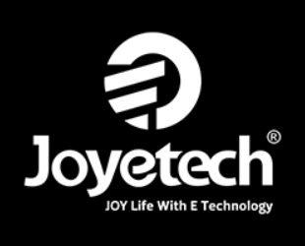
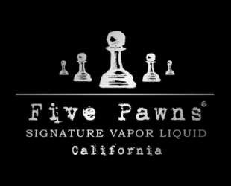
THANK YOU sponsors!

Slide 3
Vaping is safe, right? WRONG! (Covered in all episodes)
Although most studies conclude that vaping is far safer than smoking, we strongly recommend that if you do neither, you continue to do neither.
Smoking = BAD
Reducing cigarettes through vaping = GOOD
Eliminating cigarettes through vaping = BETTER
Not smoking & not vaping = BEST
If you see a negative article about vaping, question whether or not that article compared the negative to that of a traditional combustible tobacco cigarette. If it does not, in our opinion it’s invalid.
Vaping is not harm elimination! Vaping is harm reduction!

Slide 4
WHAT THEY SAY!
Centers for Disease Control and Prevention (CDC): "E-cigarettes have the potential to benefit adult smokers who are not pregnant if used as a complete substitute for regular cigarettes and other smoked tobacco products."
Source: https://www.cdc.gov/tobacco/basic_information/e-cigarettes/about-e-cigarettes.html
The U.S. Department of Health and Human Services (HHS): “E-cigarettes present an important, potentially lifesaving opportunity to help currently addicted adult smokers quit combustible cigarettes.”
Source: https://www.hhs.gov/about/news/2018/11/15/secretary-azar-comments-on-data-showing-rising-ecigarette-use-among-youth.html

Slide 5
WHAT THEY SAY!
The U.S. Department of Health and Human Services (HHS): (HHS BLOG within the site) “Yet, while e-cigarettes are less harmful than regular combustible tobacco products—and a possible pathway to tobacco-smoking cessation for adults—the evidence on the effectiveness of these products for helping adult smokers quit completely is still uncertain.”
Source: https://www.hhs.gov/blog/2018/11/6/researchers-explore-health-effects-of-ecigarettes.html
Dr. Scott Gottlieb, Food and Drug Administration (FDA): "We believe e-cigs can provide substantial health benefits helping currently addicted adult smokers fully transition off of combustible cigarettes.“
Source: https://twitter.com/SGottliebFDA/status/1094631202491895810

Slide 6
WHAT THEY SAY!
Dr. Scott Gottlieb, Food and Drug Administration (FDA): "If you could take every adult smoker and fully switch them to e-cigarettes, that would have a substantial public health impact."
Source: https://twitter.com/SGottliebFDA/status/1094631202491895810
Dr. Scott Gottlieb, Food and Drug Administration (FDA): "E-cigarettes may present an important opportunity for adult smokers to transition off combustible tobacco products and onto nicotine delivery products that may not have the same level of tisks associated with them."
Source: https://www.fda.gov/NewsEvents/Newsroom/PressAnnouncements/UCM620185.htm

Slide 7
WHAT THEY SAY!
Dr. Scott Gottlieb, Food and Drug Administration (FDA): "We've said all along we think that e-cigarettes could be a viable alternative for adult smokers. If you could migrate more adult smokers off combustible products, that would be a net public health benefit."
Source: https://www.c-span.org/video/?c4780758/fda-commissioner-scott-gottlieb
Dr. Scott Gottlieb, Food and Drug Administration (FDA): "We see the possibility for ENDS products like e-cigarettes and other novel forms of nicotine delivery to provide a potentially less harmful alternative."
Source: https://www.fda.gov/NewsEvents/Newsroom/PressAnnouncements/ucm605432.htm

Slide 8
WHAT THEY SAY!
Mitch Zeller, Director, Center for Tobacco Products: "If we could get all of those people to completely switch all of their cigarettes for one of these non-combustible products, that would be good for public health."
Source: (page 31 or “document” page 27) https://www.govinfo.gov/content/pkg/CHRG-113shrg22614/pdf/CHRG-113shrg22614.pdf
National Academies of Sciences, Engineering, and Medicine: "Evidence suggests that while e-cigarettes are not without health risks, they are likely to be far less harmful than conventional cigarettes, the report says. They contain fewer numbers and lower levels of toxic substances than conventional cigarettes, and using e-cigarettes may help adults who smoke conventional cigarettes quit smoking. However, their long-term health effects are not yet clear."
Source: http://www8.nationalacademies.org/onpinews/newsitem.aspx?RecordID=24952

Slide 9
WHAT THEY SAY!
American Heart Association: “E-cigarettes either do not contain or have lower levels of several tobacco-derived harmful and potentially harmful constituents compared with cigarettes and smokeless tobacco. In comparison with NRTs, e-cigarette use has increased at an unprecedented rate, which presents an opportunity for harm reduction if smokers use them as substitutes for cigarettes.”
Source: https://www.ahajournals.org/doi/full/10.1161/CIR.0000000000000107
American Cancer Society: “Even though e-cigarettes do not contain any tobacco, the Food and Drug Administration (FDA) classifies them as “tobacco” products.”
“Research has found that e-cigarette use is likely to be significantly less harmful than smoking regular cigarettes.”
Source: https://www.cancer.org/cancer/cancer-causes/tobacco-and-cancer/e-cigarettes.html

Slide 10
WHAT THEY SAY!
American Cancer Society: “Based on currently available evidence, using current generation e-cigarettes is less harmful than smoking cigarettes, but the health effects of long-term use are not known.”
Source: https://www.cancer.org/healthy/stay-away-from-tobacco/e-cigarette-position-statement.html
Truth Initiative: “E-cigarettes are far less toxic than cigarettes, but they are not harmless.”
“Some smokers may be unable or unwilling to quit using nicotine and would benefit by completely switching to a much lower harm nicotine delivery mechanism (including potentially a well-regulated e-cigarette).
Source: https://truthinitiative.org/news/action-needed-e-cigarettes

Slide 11
WHAT THEY SAY!
Campaign for Tobacco-Free Kids: “Under the right circumstances, e-cigarettes could benefit public health if they help significantly reduce the number of people who use combustible cigarettes.”
Source: https://www.tobaccofreekids.org/assets/factsheets/0379.pdf
Royal College of Physicians: "Available data suggest that e-cigarette health risks are unlikely to exceed 5% of those associated with smoked tobacco products, and may well be substantially lower. In the UK, harm reduction is a recognized element of comprehensive tobacco control."
Source: https://www.rcplondon.ac.uk/projects/outputs/nicotine-without-smoke-tobacco-harm-reduction-0

Slide 12
What is vaping? (Covered in all episodes)
In the context of this show and information provided, vaping is the act of using an “EVP” or “E-liquid Vaping Product”.
The E-liquid may or may not contain nicotine.

Slide 13
So you want to switch to vaping!
Decide on your direction:
Open vs. closed system.
Large vs. small device.
Internal vs. removeable batteries.
All-In-One (AIO) vs. Traditional (510).
E-Liquid Types.

Slide 14
Hardware direction
Open vs. Closed system
Open – Pros:
Cheaper.
More selection and choices.
More e-liquid choice.
More customization.
More availability in vape shops.
Open Cons:
Learning curve.
Troubleshooting.
Filling.
Match e-liquid to hardware.
Limited selection in c-stores.

Slide 15
COST OF VAPING VS. SMOKING
* Note - Some assumptions and generalities have been made
AVERAGE MOUTH TO LUNG
Assumptions
Innokin Kroma Kit w/Zenith Tank = $49.99 (MVS)
Z-Coil = $2.50 per coil (MVS)
60ml Naked E-Liquid Bottle = $18.99 (MVS)
(2) kits per year
(1) coil per week
(1) 60ml E-liquid per week
$1,217.46 PER YEAR

Slide 16
Hardware direction
Open vs. Closed system
Closed Pros:
More availability in c-stores.
Easier to deal with.
Little to no learning curve.
E-liquid is matched to the device.
Closed Cons:
Less choices.
Limited if any adjustability.
Less e-liquid choices.
More expensive.

Slide 17
COST OF VAPING VS. SMOKING
* Note - Some assumptions and generalities have been made
JUUL
Assumptions
Average Price for Juul = $34.99
Average Price for a Juul pod = $4
(2) Juul purchases per year
(1) Juul pod per day
$1,529.98 PER YEAR

Slide 18
COST OF VAPING VS. SMOKING
* Note - Some assumptions and generalities have been made
SMOKING
Assumptions
1 pack per day
Average price per pack $7.00
$2,500 PER YEAR

Slide 19
Hardware direction
Large vs. small device
Small Pros:
May be more attractive to a smoker due to size.
More convenient.
More pocket and purse friendly.
Small Cons:
Limited features
Limited adjustability
Limited battery life
Limited power

Slide 20
Hardware direction
Large vs. small device
Large Pros:
Feature rich.
Increased battery life.
Informational feedback due to screens.
Can grow and adjust with your vaping preference.
Large Cons:
May be less attractive to a smoker due to size.
Learning curve for features
Heavy and less pocket or purse friendly.

Slide 21
Hardware direction
Internal vs. external batteries (this choice mostly on medium to large devices)
Internal Pros:
Battery selection already made for you. You don’t have to figure it out.
No concern over battery covering wear.
Internal Cons:
Battery charge cycle life.
Cannot use external charger.
Cannot switch batteries when empty.

Slide 22
Hardware direction
Internal vs. external batteries (this choice mostly on medium to large devices)
External Pros:
Can use quality external smart charger.
Can switch batteries when empty.
Can choose battery you want.
External Cons:
Spare batteries must be properly protected.
Decision and confusion over which battery to use.
Battery cover wear over time. Must be aware of battery’s condition.

Slide 23
Hardware direction
All-In-One (AIO) vs. Traditional (510)
AIO Pros:
Typically easier to use.
Less parts.
System designed to work together.
AIO Cons:
Some are difficult to clean.
Typically less adjustable.

Slide 24
Hardware direction
All-In-One (AIO) vs. Traditional (510)
Traditional Pros:
510 connection gives the ability to use any tank with any device
Traditional Cons:
510 connection gives the ability to use any tank with any device

Slide 25
Liquid direction
E-Liquid Types
Standard vs. Salt.
PG/VG Ratio.
Nicotine Strength.
Flavor Profiles.

Slide 26
Liquid direction
Standard vs. Salt
Salt typically has higher nicotine strengths.
Salt is smoother with less throat hit.
Salt requires less power.
More addictive???
Standard has more “kick” when it comes to throat hit
Standard typically has more PG/VG ratio choices

Slide 27
Liquid direction
PG/VG Ratios
Higher PG
Carries flavor better.
Less vapor.
More throat hit.
Wicks easier (thinner).
Higher VG
Requires more flavoring.
Less throat hit.
More vapor.
Harder to wick (thicker).

Slide 28
Liquid direction
Nicotine Stregnth
0, 3, 6, 12, 18 (standard)
20, 50 (salt)
“Every American tobacco cigarette contains about 9 mg, but cigarette smoking burns away a lot of the nicotine. On average you’re inhaling about 1 mg of nicotine per tobacco cigarette. Therefore, a teaspoon of 12 mg e-liquid is equal to about 60 cigarettes.”
“The average, is about 12 mg per cigarette. The large majority of cigarettes fall between a range of 8 mg and 20mg.”

Slide 29
THE NEXT SMOKER’S SHOW TUESDAY, February 26th
SPECIAL GUEST AARON BIEBERT!!
To discuss & answer questions about hit new film:
“You Don't Know Nicotine - Documentary Film”
KICK STARTER FOR THE FILM (ends on Feb 25):
http://bit.ly/YouDontKnowNicotine

Slide 30
How does it work? (Covered in all episodes)
Most vaping products work the same way and contain the same components:
Power source – this component provides power to the heating element which boils the e-liquid creating the vapor.
Heating element – this component accepts power from the power source and heats the e-liquid to the boiling point creating the vapor.
Wicking – this component creates the “highway” which transfers the e-liquid to the heating element.
E-liquid – this component is boiled by the heating element and creates the vapor which you breath in.

Slide 31
Common terms (See episode #1)
You will run into many terms and acronyms when it comes to vaping. Here are a few of the more important ones.
510 – in vaping, the main connection type between the device and the atomizer.
Atomizer (Atty) – something you attach to a device or mod. It will contain the heating element, wicking, and e-liquid. There are many types:
Rebuildable – you install your own heating coil and wicking
RBA – Rebuildable atomizer
RDA – Rebuildable dripping atomizer
RTA – Rebuildable tank atomizer
RDTA – Rebuildable dripping tank atomizer
Replaceable – contains a user replaceable coil head
Coil – the main type of heating element. There are many different kinds of coil materials:
Nichrome – typically used in wattage mode, but can also be used in temperature control.
Kanthal – used only in wattage mode.
Stainless steel – can be used in wattage or temperature control modes.
Titanium – typically used in temperature control mode only.
Nickel – used only in temperature control mode.
Device or “mod” – a power supply for use with an atomizer – can contain user-replaceable or non-user-replaceable (internal) batteries.
Mechanical – a vaping device containing no circuitry, regulation, or safety. Should be used by experienced and knowledgeable vapers only.
Regulated – contains circuitry and safety features. A regulated device may or may not allow you to adjust your settings.
Dripping – dripping when using an RDA requires you to manually drip the liquid into the atomizer to keep the wick wet.
Resistance – heating elements come in different resistances. Differences here will affect performance, power requirements, vape temperature, responsiveness, and more.
Squonking – the act of pressing or squeezing a bottle contained in your device. This will inject e-liquid up into your atomizer. This requires an atomizer capable of being bottom fed. It’s like dripping, only upside down.
Sub-Ohm – a coil less with a resistance less than 1Ω.
Throat hit – the sensation or “thump” you feel in the back of your throat when vaping. This simulates the same sensation when smoking.
Watt – a measurement of power delivered to the heating element.

Slide 32
Vaping myths – Debunked (See Episode #1)
Vaping is just as or more harmful than smoking
Many studies including one from the Royal College of Physicians estimate vaping to be 95% safer than traditional combustible tobacco cigarettes.
The vapor contains formaldehyde
This information was based on a invalid study where unrealistic testing conditions produced “dry puffs” and thus meaningless results.
E-liquid contains antifreeze
This information was based on a 2009 study where 18 e-liquid cartridges were tested and one contained diethylene glycol, a chemical used in industrial antifreeze that is toxic to humans. The level found was nearly untraceable at around 1%. This should not be a concern with modern e-liquid manufacturing practices & techniques from reputable companies.
E-liquids do contain propylene glycol (PG), which is sometimes used in antifreeze as an additive to make it less dangerous if swallowed. The Food and Drug Administration (FDA) has classified PG as an additive that is "generally recognized as safe“ for human consumption.
Nicotine is bad for you
Nicotine, while certainly addictive, is not carcinogenic and has never been linked to cancer. Outside of that, there are debates as to the good and bad of nicotine:
THE GOOD - Nicotine consumption may increase the speed of sensory information processing, relieve stress, anxiety, and panic attacks, and more.
THE BAD - Nicotine is a stimulant, much like caffeine. Nicotine can kick start your adrenal glands and give you a bit of adrenaline. Nicotine can cause a short term increase in heart rate and blood pressure but only temporarily, same as your coffee.

Slide 33
Vaping myths – Debunked (continued) (See Episode #5)
Teens inhaling cancer causing chemicals
See video: https://www.youtube.com/watch?v=gEZnsgz_stM

Slide 34
I WANT TO QUIT SMOKING!
Recommended Methods – Desirable to Least Desirable
Cold Turkey – JUST QUIT!
Traditional Methods – Patches, Gums, Medications
Vaping – Via Traditional Nic liquids
Vaping – Via Salt Nic liquids
ALWAYS REMEMBER - Vaping is not harm elimination! Vaping is harm reduction! The safest way to vape is to not vape at all.

Slide 35
Styles
Mouth To Lung (MTL) – The act of bringing the vapor into your mouth first, then inhaling it into your lungs. 99% of smokers use the MTL style when using a cigarette. Typically a tighter draw more similar to that of a cigarette.
Direct Lung/Lung Hitting (DL) – the act of taking the vapor from the EVP directly into your lungs. If you’ve ever smoked those funny looking cigarettes back in your college days, you’re familiar with “Direct Lung” inhales. Typically a looser draw.
Note: Although these are the two major styles of vaping, there are certainly ranges and draw resistances within each style, such as “restricted direct lung” (RDL). Airflow controllers and different types of atomizers and devices allow you to find what is best and most comfortable for you.

Slide 36
What DO I Have to do?
Closed POD type systems
Charge, replace pods
Open POD type systems
Charge, fill pods, replace pods
All-In-Ones
Charge, fill e-liquid, replace coil heads, clean
Tanks (replaceable coil heads)
Fill e-liquid, replace coil heads, clean
Tanks (rebuildable)
Create and install build, wick, replace wick, replace coil, fill with e-liquid, clean

Slide 37
What DO I Have to KNOW? (Bare Minimum)
What is E-liquid (Juice)?
The liquid that is heated, turned to vapor, and inhaled into your lungs
Contains PG/VG/Nic/Flavors
Higher VG will produce more vapor, less throat hit, and will be more difficult to wick (thicker)
What is mAh?
mAh is the capacity rating of the battery. Higher mAh will give you more vape time on a charge
What is resistance (Ohms/Ω)
Coils come in different resistances and materials. An Ohm is a measurement of that resistance. When current is run through the coil, it will heat because of it’s resistance.
Higher resistance coils require lower power levels.
Higher resistance coils will create a cooler vape.
Lower resistance coils require more power.
Lower resistance coils will create a warmer vape.
What is Mouth To Lung (MTL) Vs. Direct Lung (DL)
The two main styles of vaping
MTL is how most people will smoke a cigarette, first taking the smoke into their mouth and then into their lungs.
DL is the act of taking the vapor directly into their lungs
What is wattage?
Wattage is the “volume control” of adjustable E-liquid Vaping Products. As you increase the EVP’s wattage, you increase the power to the coil making it hotter.

Slide 38
What are my consumables?
Closed POD type systems
The pod (already contains e-liquid)
Open POD type systems
The pod, e-liquid
All-In-Ones
E-liquid, coil heads
Tanks (replaceable coil heads)
E-liquid, coil heads
Tanks (rebuildable)
E-liquid, coils, wicking material

Slide 39
What’s in the liquid? (See Episode #2)
E-liquids will generally contain 4 main ingredients. Those ingredients are:
Propylene Glycol (PG)
PG is a colorless, odorless liquid. It’s used in the food industry as a flavoring carrier, an ingredient in food coloring, an additive in various medicines, and the active ingredient in asthma inhalers and nebulizers. Propylene Glycol is non toxic and is "generally recognized as safe“ for human consumption by the FDA in moderate quantities.
Vegetable Glycerin (VG)
VG is a colorless, odorless liquid derived from plant oils. Although it’s processed from oils, it isn’t an oil, but rather an alcohol which makes it safe to inhale. It’s used in the food industry as a sweetener and to keep foods moist. Medicines also contain VG. Vegetable Glycerin is non toxic and is "generally recognized as safe“ for human consumption by the FDA in moderate quantities.
Flavorings
E-liquid is flavored with food-grade flavorings.
Nicotine

Slide 40
Types of e-liquids (See Episode #2)
Higher PG
Produces less vapor.
Generally thinner and easier to wick.
Could be considered more “harsh” and provide more of a throat hit (TH). The nicotine concentration can also affect the amount of TH.
Higher VG
Produces more vapor.
Generally thicker and more difficult to wick.
Could be considered “smoother” with less of a throat hit. The nicotine concentration can also affect the amount of TH.
Salt-Nicotine E-liquids
A newer type of e-liquid that utilizes nicotine salts as apposed to the more standard freebase nicotine. The process used to create the nicotine salt creates a nicotine that is smoother with less TH and a faster absorption rate. This is good for those who require high nicotine levels to be successful with vaping. It’s also good for smaller, less powerful devices such as small pod systems.

Slide 41
Types of evps
There are now thousands of vaping products on the market. They can be broken down into a few different types:
Device or “Mod” – this is a power supply only. It requires an atomizer to operate.
All-In-One (AIO) – a device that incorporates the atomizer.
NOTE – Devices, mods, and AIOs come in different form factors such as tubes (sticks) or box formats.
Open systems – these products allow you to open and refill the product with your own e-liquid.
Closed systems – these products do not allow you to refill them. Once emptied of e-liquid, you will generally need to purchase a new tank or “pod”
Disposable – these are one time use products. Once emptied of e-liquid, they are designed to be thrown away.
Features – Feature sets will vary by devices. Some will have none, some will have many. Here is a sample of features you will run into:
Adjustability (wattage and temperature)
Temperature Control
Custom Curves
Firmware Upgradeability
Information screens (black and white & color)
Custom TCR Values (Temperature Coefficient of Resistance) – Used with temperature control
Date/Time features

Slide 42
Types of COILS (See Episode #2)
You will hear the term “coil” many times in vaping but it can mean different things:
Coil Head: this is a pre-built coil encapsulated in an enclosure with wicking included. This is for use in a “replaceable” atomizer. They will typically screw in and out of an atomizer and are usually proprietary to the atomizer they are made for. They will come in different configurations, materials, and resistances.
Build your own: this is when you use raw wire to create your own coil or heating element. It will also need to be wicked by you. This coil is used in a “rebuildable type atomizer such as:
RBA – Rebuildable atomizer
RDA – Rebuildable dripping atomizer
RTA – Rebuildable tank atomizer
RDTA – Rebuildable dripping tank atomizer
Pre-Built: The coil has already been created for you for use in one of the “rebuildable” type atomizers listed above. You will also need to wick this type of coil.
Coil materials, prebuilt, and coil heads can come in numerous materials, types, resistances, gauges, configurations, and styles.
Sample materials - Kanthal, stainless steel, nickel, titanium, nichrome
Sample types – round, flat, mesh
Sample resistances – 1.5ohm, 1ohm, .8ohm, .4ohm
Sample gauges – 28g, 26g, 24g
The higher the number, the thicker the wire and the lower the resistance per inch.
Sample configurations – Single, dual, quad, touching, spaced
Sample styles – Twisted, Clapton, Fused Clapton, Staggered Clapton, Tiger, Alien, Helix, Zipper, etc.
These may also be considered “exotic” coils. They style names represent how single core wires have been twisted and weaved together.

Slide 43
Types of TANKS (see episode #3)
Here is a further breakdown of the type of tanks you’ll come across in vaping.
Styles – Tanks will fall in to the following vaping styles. Some tanks can be used across multiple styles:
MTL – Mouth to lung
DL – Direct to lung
RDL – Restricted direct lung
Filling – Tanks can be filled in a variety of ways:
Top fill
Bottom Fill
Side Fill
Dripped
Squonked
Types – Tanks will fall into to main categories with sub-categories of each:
Replaceable – contains a user-replaceable coil head
Rebuildable (RBA) – the user much build their own coil (or use a pre-built coil) and install and wick it themselves. There are many different kinds of rebuildable tanks:
RTA – Rebuildable tank atomizer
RDA – Rebuildable dripping atomizer
RDTA – Rebuildable dripping tank atomizer
GTA – Genesis tank atomizer
BF – Bottom Feeding (Squonking)
Pod – pods are types of tanks that contain the coil and wicking. They are typically sealed and do no give you access to the coil or the wicking material. At the moment, there are no rebuildable pods. They are generally created for one-time or limited use. Some pods allow you to change the coils as seen on the Joyetech Dolphin. There are two main types of pods:
Open – They allow you to refill them with your own e-liquid.
Closed – These are one-time use pods that come prefilled with liquid. Once the liquid is out, the pod becomes disposable.

Slide 44
Welcome our Special guest! (See Episode #4)
JOHN MUCHOW AKA “BATTERY MOOCH”
ECF Blog - https://www.e-cigarette-forum.com/blogs/mooch.256958/
Facebook - https://www.facebook.com/batterymooch/
Reddit - https://www.reddit.com/user/mooch315
YouTube - https://www.youtube.com/channel/UCePHh3NMvu3rW2LFJeOWo-Q
Instagram - batterymooch

Slide 45
COST OF VAPING VS. SMOKING
* Note - Some assumptions and generalities have been made
SMOKING
Assumptions
1 pack per day
Average price per pack $7.00
$2,500 PER YEAR

Slide 46
COST OF VAPING VS. SMOKING
* Note - Some assumptions and generalities have been made
AVERAGE DIRECT LUNG
Assumptions
SMOK I-Priv kit w/ TFV12 Tank = $57.99 (MVS)
TFV Coil = $4.66 per coil (MVS)
60ml Naked E-Liquid Bottle = $18.99 (MVS)
(2) kits per year
(1) coil per week
(2) 60ml E-liquid per week
$2,333.26 PER YEAR

Slide 47
COST OF VAPING VS. SMOKING
* Note - Some assumptions and generalities have been made
JUUL
Assumptions
Average Price for Juul = $34.99
Average Price for a Juul pod = $4
(2) Juul purchases per year
(1) Juul pod per day
$1,529.98 PER YEAR

Slide 48
COST OF VAPING VS. SMOKING
* Note - Some assumptions and generalities have been made
JUNO
Assumptions
Average Price for Juno* = $24.95
Average Price for a Juno pod = $4
(2) Juno purchases per year
(1) Juno pod per day
$1,494.16 PER YEAR
*Prices found on electrictobacconist.com

Slide 49
COST OF VAPING VS. SMOKING
* Note - Some assumptions and generalities have been made
LEAP
Assumptions
Average Price for Leap* = $19.99
Average Price for a Leap pod = $4
(2) Leap purchases per year
(1) Leap pod per day
$1,493.38 PER YEAR
*Prices found on electrictobacconist.com

Slide 50
COST OF VAPING VS. SMOKING
* Note - Some assumptions and generalities have been made
AVERAGE OPEN POD
Assumptions
Innokin EQ = $24.99 (MVS)
Replacement EQ Pods = $3.99 per pod (MVS)
30ml Salt Bae E-Liquid Bottle = $17.99 (MVS)
(2) kits per year
(2) pods per week
(1) 30ml E-liquid per week
$1,400.42 PER YEAR

Slide 51
COST OF VAPING VS. SMOKING
* Note - Some assumptions and generalities have been made
AVERAGE MOUTH TO LUNG
Assumptions
Innokin Kroma Kit w/Zenith Tank = $49.99 (MVS)
Z-Coil = $2.50 per coil (MVS)
60ml Naked E-Liquid Bottle = $18.99 (MVS)
(2) kits per year
(1) coil per week
(1) 60ml E-liquid per week
$1,217.46 PER YEAR

Slide 52
COST OF JUUL E-LIQUID
JUUL E-LIQUID
JUUL Pod = .7ml of E-liquid
Average Price for a JUUL Pod = $4
Subtract $3 for cost of pod, coil, and filling (I’m being VERY conservative here)
JUUL E-Liquid = $1 per .7ml
Equivalent price for JUUL E-Liquid 30ml = $42.86
Equivalent price for JUUL E-Liquid 60ml = $85.71
STANDARD E-LIQUID
Price for Mr. Salt-E E-Liquid 30ml bottle from MVS = $14.99 = 65% savings over Juul E-Liquid
Price for Naked 100 E-Liquid 60ml bottle from MVS = $18.99 = 77.84% savings over Juul E-liquid

Slide 53
COST OF VAPING VS. SMOKING

Slide 54
Building
WHY BUILD?
Save money on pods and coil heads
Customize to your preferences and materials
Large selection of rebuildables on the market
Excellent flavor
Hobbyist/Enthusiast/Passion – Vaping can be more than just vaping
Possible bans

Slide 55
Building
WHAT YOU’LL NEED?
An RBA – RDA, RTA, RDTA
Cotton/Wicking Material
Wire
Tools
Resistance reader
Screwdrivers
Flush wire cutters (Micro Shear Flush Cutter with Lead Retainer)
Scissors
Ceramic Tweezers
Needle nose pliers
Patience! ☺

Slide 56
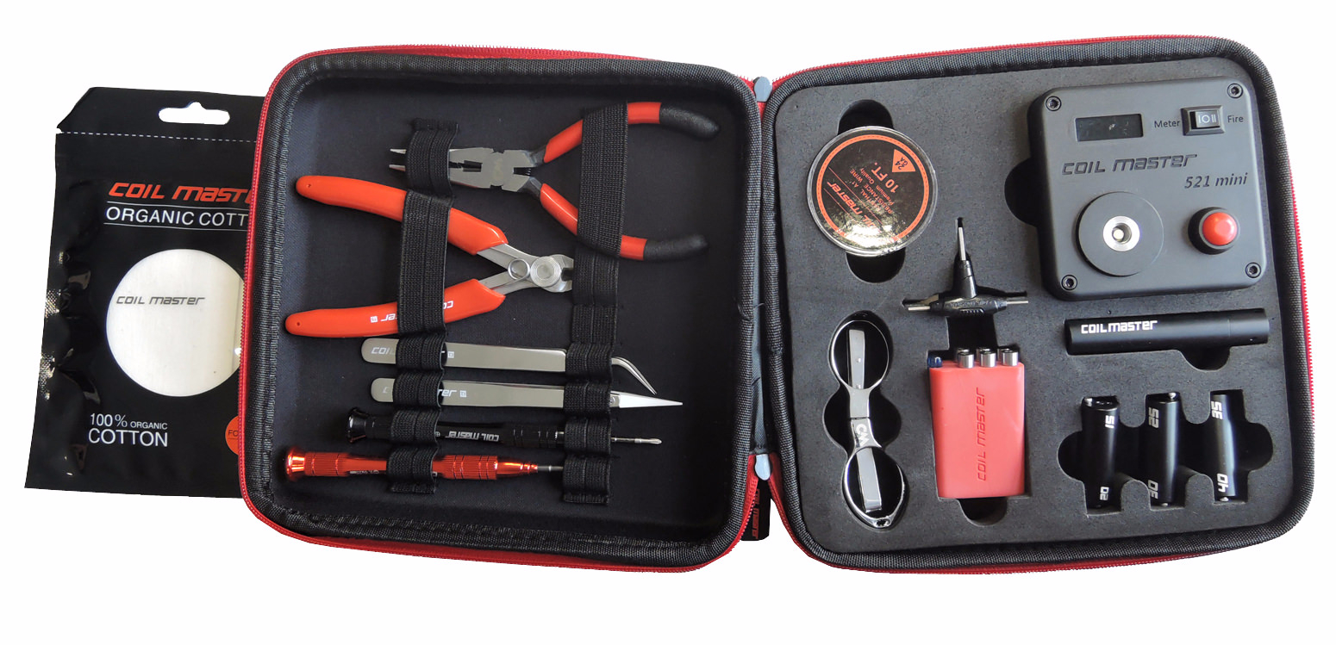
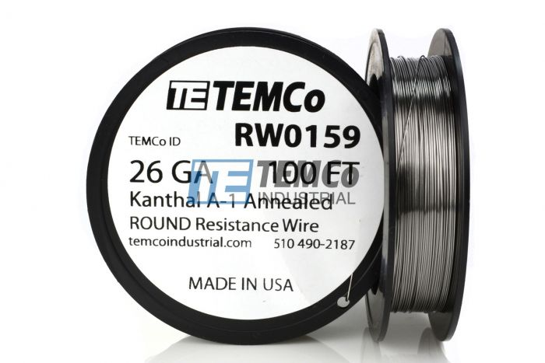
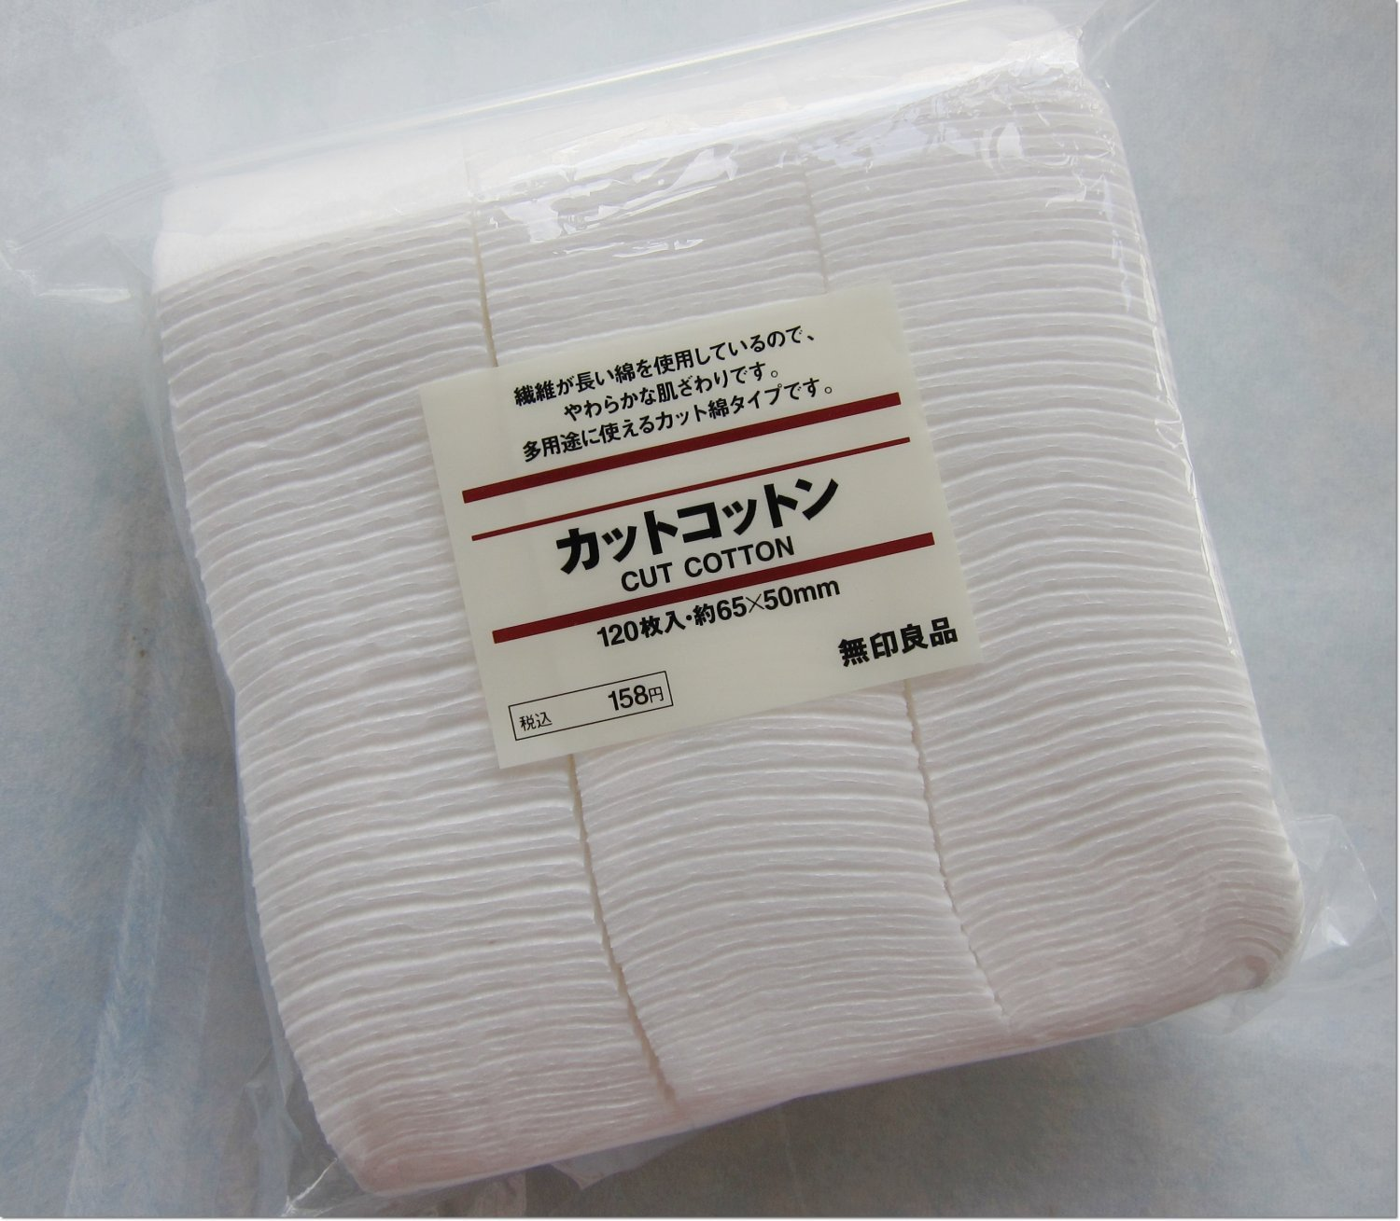
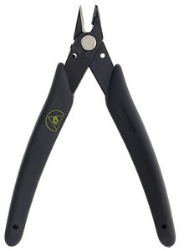
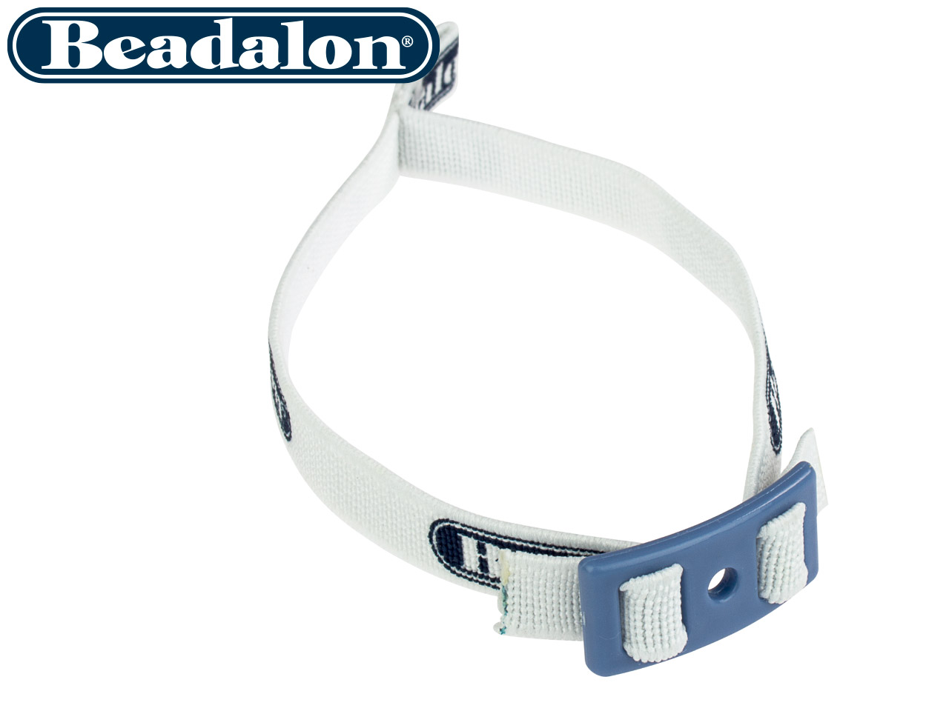
Building
SUGGESTIONS
Coil Master DIY Kit V3 - $43.99 from MyVaporStore
Wire – Specific for vaping OR Temco from Ebay
100ft 26 gauge Kanthal - $7.39
100ft 26 gauge SS316L - $5.95
Cotton – Specific for vaping OR Japanese Organic Unbleached Cotton – Amazon/Ebay
60 sheets Koh Gen Do – Amazon - $15.00
180 sheets Muji – Amazon – $6.48
Xuron - 410ASF Micro-Shear® Flush Cutter - $12.98 Ebay
Beadalon Artistic Wire SPOOL TAMER – Ebay - $12.35 for a 25-pack

Slide 57
Temperature control
More Coming Soon!

Slide 58
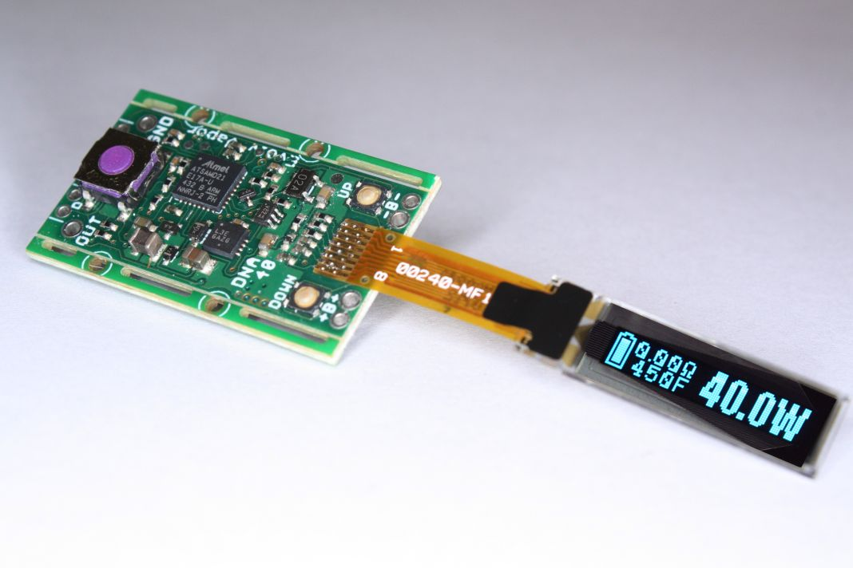
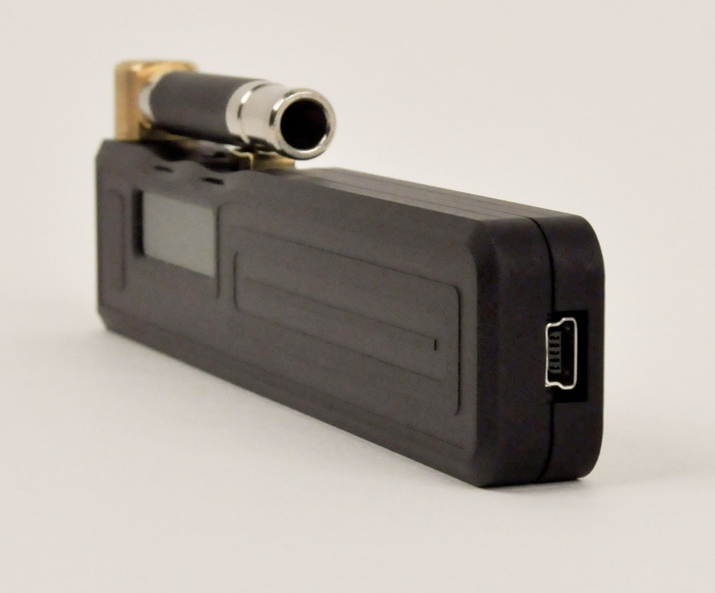
Temperature control
WHAT IS IT?
Introduced by Evolv (www.evolvapor.com) in 2014 it was a way to control the temperature of the coil for safety, consistency, and avoiding “dry hits”.
Original coil material to use temperature control was NI200.
First board to support Temperature Control was the Evolv DNA-40.
This is the second time Evolv has changed the vape scene. The first time was the introduction of the Darwin in 2010 which moved the industry away from adjusting in Voltage and moved to adjusting in Wattage. The Darwin was capable of 12.7 Watts maximum!

Slide 59
Temperature control
HOW DOES IT WORK?
Temperature control works by measuring the change of resistance in the coil as the coil heats up.
Knowing the starting resistance of the coil and the baseline temperature it’s able to assume the temperature of the coil based on the resistance increase.
This is why it’s very important to mate a cool atomizer with a cool mod when setting up for temperature control.
Since different wires resistance’s change differently as they heat up, this is why it’s important to set the wire on the device you’re using. (TCR – Temperature Coefficient of Resistance)

Slide 60
Temperature control
WHAT I INITIALLY THOUGHT ABOUT IT
Dry coil vaping in Vegas!
WOW!!!
Going to change everything!
Liquids with temperature recommendations!

Slide 61
Temperature control
WHAT I NOW THINK ABOUT IT
Difficult to use
Difficult to set-up
Inconsistent results over different devices and atomizers
Inaccurate
Not for beginners

Slide 62
Temperature control
WHY DO I CONTINUE TO USE IT?
Consistent vape
Fast ramp up without over shooting
No dry hits when tank is empty
Avoid bad stuff
Reduce “flavor creep” when changing flavors
Increase in coil and wick like

Slide 63
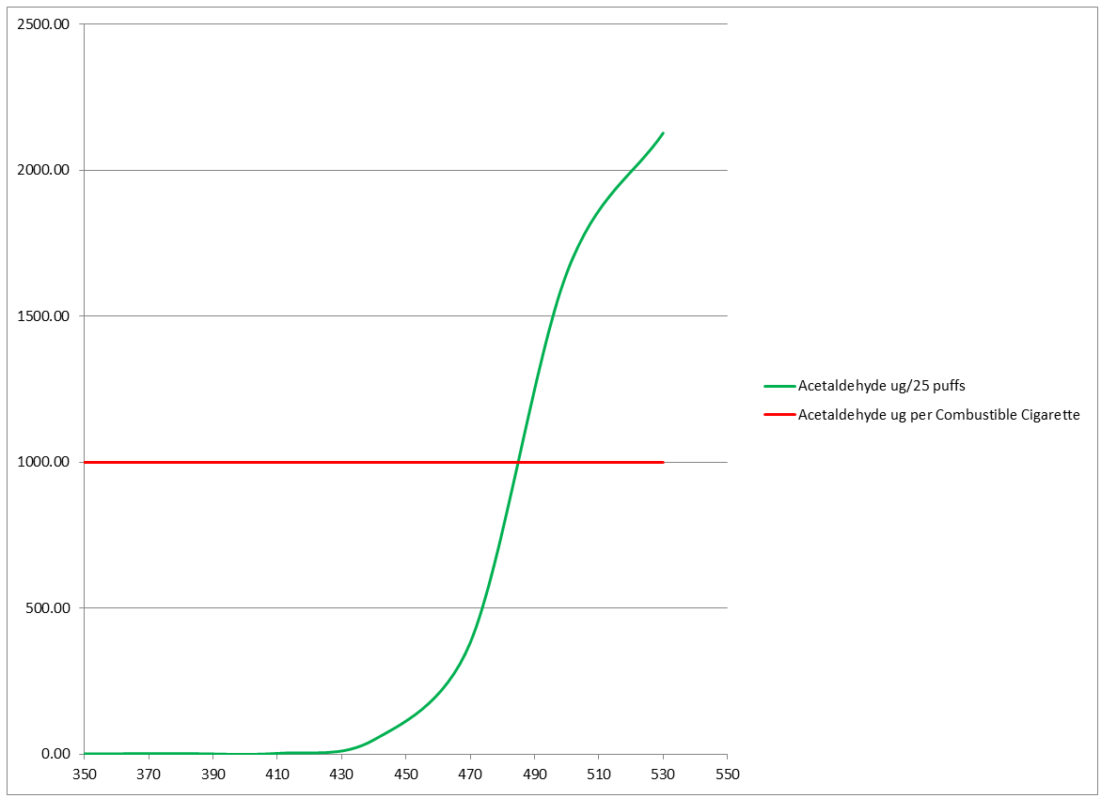
Temperature control
AVOID BAD STUFF?
“Acetaldehyde is a known human carcinogen. It is the least bad of the big three. The data for Formaldehyde and Acrolein (the second worst and worst things in the vape, by far) are even worse. ”
– Anonymous Source

Slide 64
Temperature control
FAST RAMP UP?

Slide 65
Temperature control
FAST RAMP UP?

Slide 66
Temperature control
FAST RAMP UP?

Slide 67
Temperature control
WHY SO CHALLENGING?
Affected by outside temperatures
Evolv technology uses “case thermals” to reduce this effect.
Different materials (wire) and their TCR values
The 510 – not the best electrical connection
Set-up
Small resistances in the mod and the atomizer can affect results
Need a resistance stable coil

Slide 68
Temperature control
WHAT WIRE MATERIALS CAN I USE?
* Ni200 *
* Ti01 *
* SS316L *
NiFe30 (Resistherm)
Tungsten
SS430
SS304
SS317

Slide 69
Tips for success
Don’t give up!
Identify the device that is right for you, not what they’re trying to sell you!
Experiment with different flavors!
Don’t use the same flavor for too long! Switch it up!
Get your nicotine! You’re going to need nicotine to succeed! Worry about reducing your levels later!
Don’t change your habits! Do what you did before, only now do it with your EVP!
Reach out with questions and for support. We’re here to help!
REMEMBER, THE ONLY PERFECT VAPE, IS THE PERFECT VAPE FOR YOU!!

